Slide 1
Monetary and Fiscal Policies Interactions in Mexico: 1981 – 2016 and preliminary evidence for Brazil, Chile, Colombia and Peru
Sebastian Cadavid Sánchez André C. Martínez Fritscher Alberto Ortiz Bolaños
XIII Reunión de Responsables de Política Monetaria
Banco Central de Bolivia
June 8-9, 2017
The views expressed in this presentation are those of the author and not necessarily those of CEMLA.

Slide 2
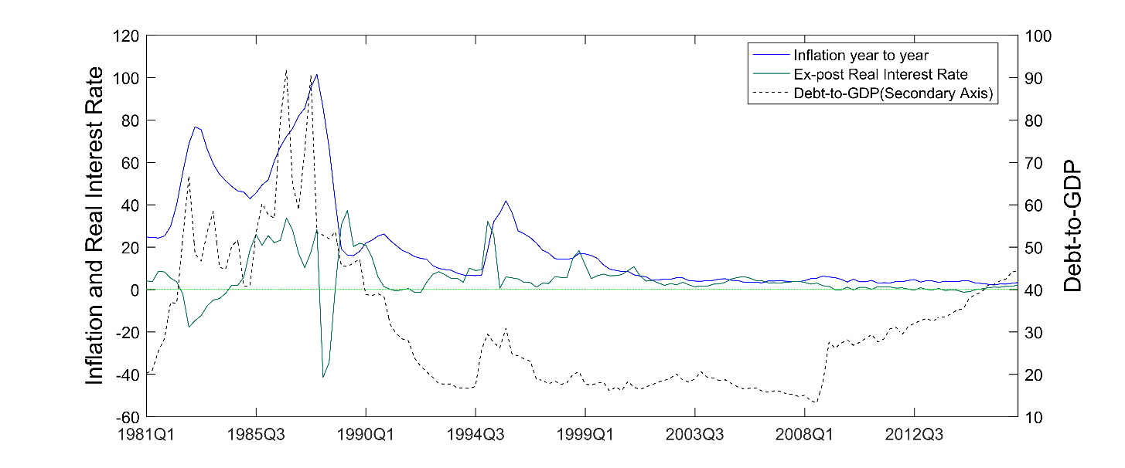
1. Introduction
Analysis of the role of monetary and fiscal policies in the determination of inflation and government debt in Mexico during the 1981 - 2016 period.
The analysis is done with an estimated Markov-switching DSGE model and the results are compared with an historical account of the Mexican monetary and fiscal policy mix.
Monetary policy is classified as active when the interest rate response to inflation is larger than one and passive otherwise. Fiscal policy is classified as active when the debt process is non-stationary and passive otherwise.
The policy space allows to distinguish four policy regimes: Passive Monetary and Passive Fiscal (PM/PF), Passive Monetary and Active Fiscal (PM/AF), Active Monetary and Passive Fiscal (AM/PF) and Active Monetary and Active Fiscal (AM/AF).
For the case of Mexico, five different periods of fiscal and monetary policies interaction configurations are identified, which are congruent to the macroeconomic environment, as well as the institutional and macro policy changes that Mexico had during the last 35 years: 1 ) 1981Q1 - 1988Q3: PM/AF, 2) 1989Q1 - 1995Q3: AM/PF, 3) 1995Q4 - 2001Q3: PM/AF, 4) 2001Q4 - 2008Q1: AM/PF and 5) 2008Q2-2015Q4: AM/AF.

Slide 3
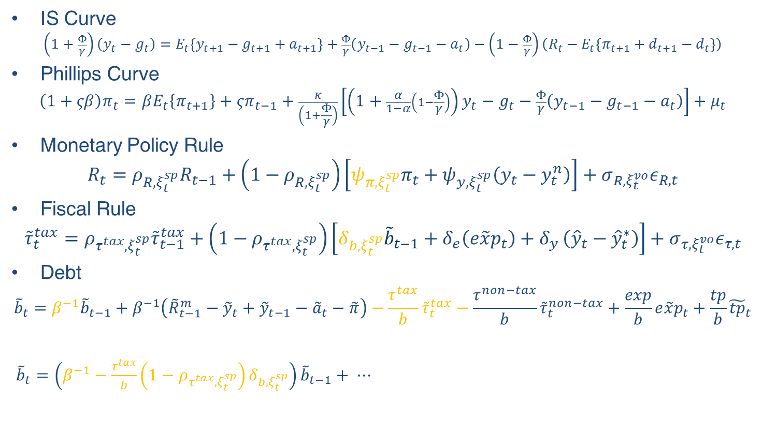
2.1 A Monetary – Fiscal Policy DSGE Model
Francesco Bianchi and Cosmin Ilut (forthcoming in Review of Economic Dynamics)
IS Curve
$$\left(1+\frac{Φ}{γ}\right)\left(y_{t}−g_{t}\right)=E_{t}\left\{y_{t+1}−g_{t+1}+a_{t+1}\right\}+\frac{Φ}{γ}\left(y_{t−1}−g_{t−1}−a_{t}\right)−\left(1−\frac{Φ}{γ}\right)\left(R_{t}−E_{t}\left\{π_{t+1}+d_{t+1}−d_{t}\right\}\right)$$
Phillips Curve
$$\left(1+ςβ\right)π_{t}=βE_{t}\left\{π_{t+1}\right\}+ςπ_{t−1}+\frac{κ}{\left(1+\frac{Φ}{γ}\right)}\left[\left(1+\frac{α}{1−α}\left(1−\frac{Φ}{γ}\right)\right)y_{t}−g_{t}−\frac{Φ}{γ}\left(y_{t−1}−g_{t−1}−a_{t}\right)\right]+μ_{t}$$
Monetary Policy Rule
$$R_{t}=ρ_{R,ξ_{t}^{sp}}R_{t−1}+\left(1−ρ_{R,ξ_{t}^{sp}}\right)\left[ψ_{π,ξ_{t}^{sp}}π_{t}+ψ_{y,ξ_{t}^{sp}}\left(y_{t}−y_{t}^{n}\right)\right]+σ_{R,ξ_{t}^{vo}}ε_{R,t}$$
Fiscal Rule
$${\tilde{τ}}_{t}^{tax}=ρ_{τ^{tax},ξ_{t}^{sp}}{\tilde{τ}}_{t−1}^{tax}+\left(1−ρ_{τ^{tax},ξ_{t}^{sp}}\right)\left[δ_{b,ξ_{t}^{sp}}{\tilde{b}}_{t−1}+δ_{e}\left({e\tilde{x}p}_{t}\right)+δ_{y }\left({\hat{y}}_{t}−{\hat{y}}_{t}^{∗}\right)\right]+σ_{τ,ξ_{t}^{vo}}ε_{τ,t}$$
Debt
$${\tilde{b}}_{t}=β^{−1}{\tilde{b}}_{t−1}+β^{−1}\left({\tilde{R}}_{t−1}^{m}−{\tilde{y}}_{t}+{\tilde{y}}_{t−1}−{\tilde{a}}_{t}−\tilde{π}\right)−\frac{τ^{tax}}{b}{\tilde{τ}}_{t}^{tax}−\frac{τ^{non−tax}}{b}{\tilde{τ}}_{t}^{non−tax}+\frac{exp}{b}{e\tilde{x}p}_{t}+\frac{tp}{b}{\tilde{tp}}_{t}$$
${\tilde{b}}_{t}=\left(β^{−1}−\frac{τ^{tax}}{b}\left(1−ρ_{τ^{tax},ξ_{t}^{sp}}\right)δ_{b,ξ_{t}^{sp}}\right){\tilde{b}}_{t−1}+ ⋯$

Slide 4
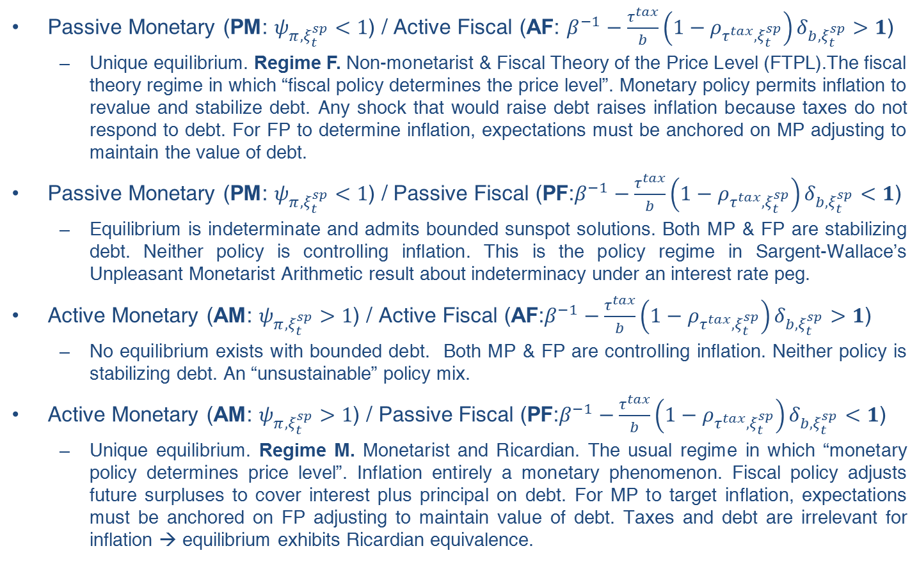
2.2 Monetary and Fiscal Policy Mix
Passive Monetary (PM: $ψ_{π,ξ_{t}^{sp}}<1$) / Active Fiscal (AF: $β^{−1}−\frac{τ^{tax}}{b}\left(1−ρ_{τ^{tax},ξ_{t}^{sp}}\right)δ_{b,ξ_{t}^{sp}}>1$)
  Unique equilibrium. Regime F. Non-monetarist & Fiscal Theory of the Price Level (FTPL).The fiscal theory regime in which “fiscal policy determines the price level”. Monetary policy permits inflation to revalue and stabilize debt. Any shock that would raise debt raises inflation because taxes do not respond to debt. For FP to determine inflation, expectations must be anchored on MP adjusting to maintain the value of debt.
Passive Monetary (PM: $ψ_{π,ξ_{t}^{sp}}<1$) / Passive Fiscal (PF:$β^{−1}−\frac{τ^{tax}}{b}\left(1−ρ_{τ^{tax},ξ_{t}^{sp}}\right)δ_{b,ξ_{t}^{sp}}<1$)
  Equilibrium is indeterminate and admits bounded sunspot solutions. Both MP & FP are stabilizing debt. Neither policy is controlling inflation. This is the policy regime in Sargent-Wallace’s Unpleasant Monetarist Arithmetic result about indeterminacy under an interest rate peg.
Active Monetary (AM: $ψ_{π,ξ_{t}^{sp}}>1$) / Active Fiscal (AF:$β^{−1}−\frac{τ^{tax}}{b}\left(1−ρ_{τ^{tax},ξ_{t}^{sp}}\right)δ_{b,ξ_{t}^{sp}}>1$)
  No equilibrium exists with bounded debt. Both MP & FP are controlling inflation. Neither policy is stabilizing debt. An “unsustainable” policy mix.
Active Monetary (AM: $ψ_{π,ξ_{t}^{sp}}>1$) / Passive Fiscal (PF:$β^{−1}−\frac{τ^{tax}}{b}\left(1−ρ_{τ^{tax},ξ_{t}^{sp}}\right)δ_{b,ξ_{t}^{sp}}<1$)
  Unique equilibrium. Regime M. Monetarist and Ricardian. The usual regime in which “monetary policy determines price level”. Inflation entirely a monetary phenomenon. Fiscal policy adjusts future surpluses to cover interest plus principal on debt. For MP to target inflation, expectations must be anchored on FP adjusting to maintain value of debt. Taxes and debt are irrelevant for inflation → equilibrium exhibits Ricardian equivalence.

Slide 5
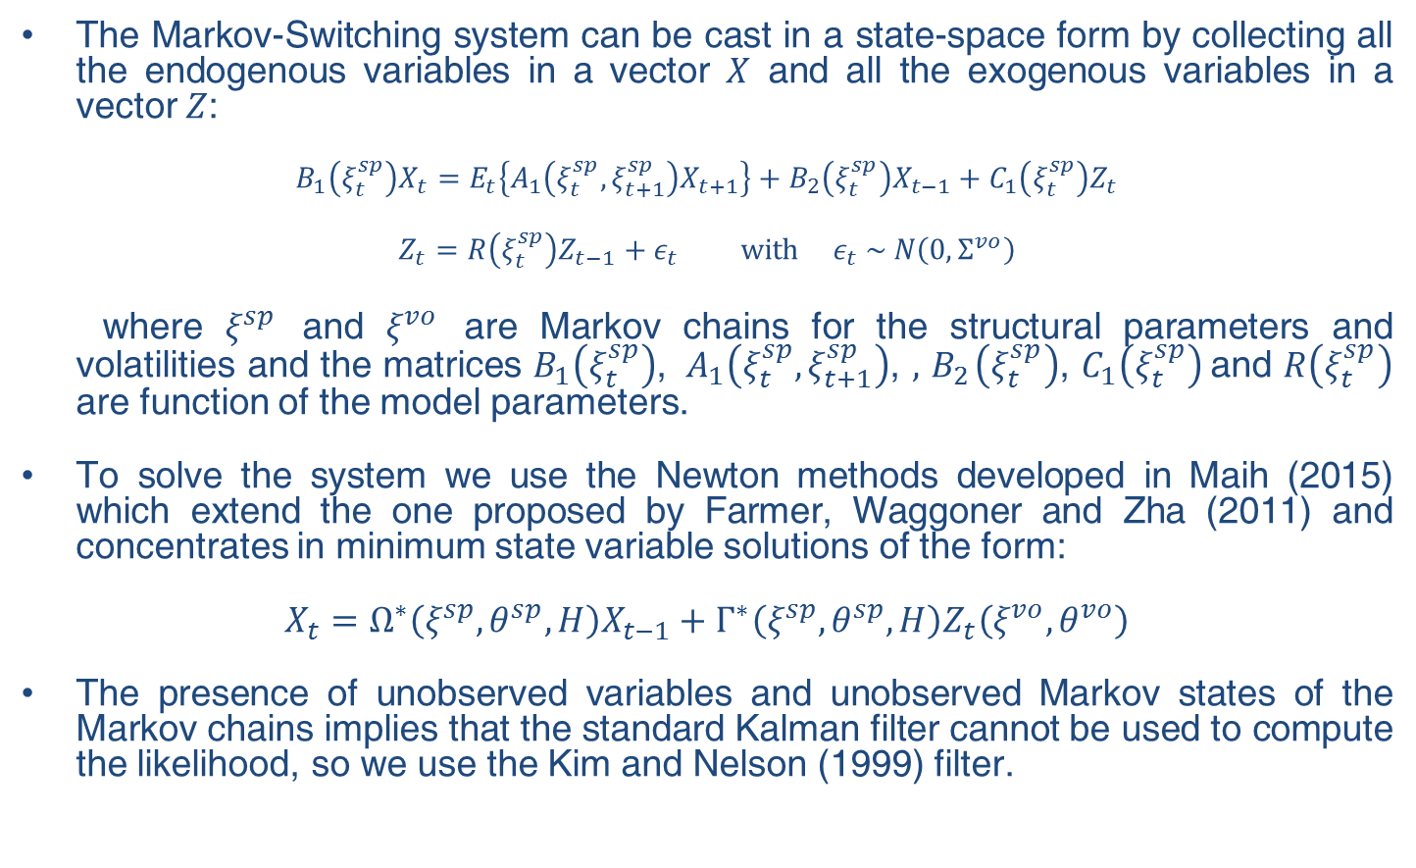
2.3 Solving and estimating the MS-DSGE model
The Markov-Switching system can be cast in a state-space form by collecting all the endogenous variables in a vector $X$ and all the exogenous variables in a vector $Z$:
$$B_{1}\left(ξ_{t}^{sp}\right)X_{t}=E_{t}\left\{A_{1}\left(ξ_{t}^{sp},ξ_{t+1}^{sp}\right)X_{t+1}\right\}+B_{2}\left(ξ_{t}^{sp}\right)X_{t−1}+C_{1}\left(ξ_{t}^{sp}\right)Z_{t}$$
$$Z_{t}=R\left(ξ_{t}^{sp}\right)Z_{t−1}+ε_{t} with ε_{t} \sim N\left(0, Σ^{vo}\right)$$
wwhere $ξ^{sp}$ and $ξ^{vo}$ are Markov chains for the structural parameters and volatilities and the matrices $B_{1}\left(ξ_{t}^{sp}\right)$, ${ A}_{1}\left(ξ_{t}^{sp},ξ_{t+1}^{sp}\right)$, $,{ B}_{2}\left(ξ_{t}^{sp}\right)$, $C_{1}\left(ξ_{t}^{sp}\right)$and $R\left(ξ_{t}^{sp}\right)$ are function of the model parameters.
To solve the system we use the Newton methods developed in Maih (2015) which extend the one proposed by Farmer, Waggoner and Zha (2011) and concentrates in minimum state variable solutions of the form:
$$X_{t}=Ω^{∗}\left(ξ^{sp},θ^{sp},H\right)X_{t−1}+Γ^{∗}\left(ξ^{sp},θ^{sp},H\right)Z_{t}\left(ξ^{vo},θ^{vo}\right)$$
The presence of unobserved variables and unobserved Markov states of the Markov chains implies that the standard Kalman filter cannot be used to compute the likelihood, so we use the Kim and Nelson (1999) filter.

Slide 6
2.3 Solving and estimating (cont.)
We use the Bayesian approach to estimate the model:
  Use Farmer, Waggoner and Zha (2011) algorithm to compute the likelihood introducing non-linearities and unobserved chains employing the Kim and Nelson (1999) filter to compute the likelihood with prior distribution of the parameters.
  Construct the posterior kernel with the estimates from the Bee-gate optimizer routine.
  We use the posterior mode as the initial value for the Metropolis Hastings algorithm with 200,000 iterations.
  Utilize mean and variance of the last 100,000 iterations from (3) to run the main Metropolis Hastings algorithm.
Observables:
  Real GDP growth
  Annualized inflation
  Interest rate
  Annualized Debt to GDP ratio
  Fiscal income: Federal tax and non-tax revenues (GDP fraction)
  Debt and federal expenditure (GDP fraction)

Slide 7
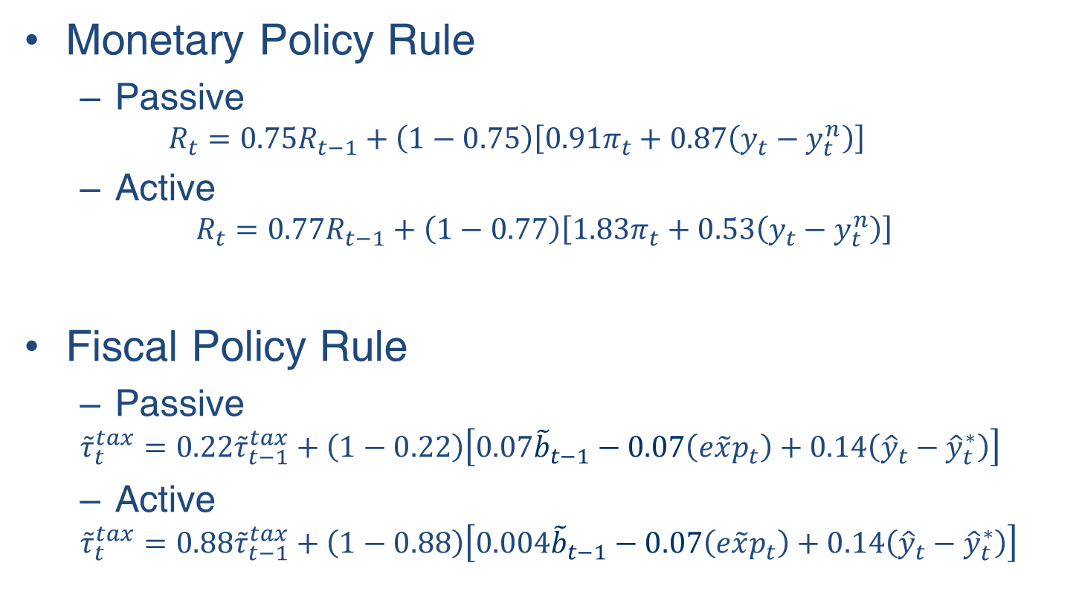
3.1 Parameter estimates
Monetary Policy Rule
  Passive
  $$R_{t}=0.75R_{t−1}+\left(1−0.75\right)\left[0.91π_{t}+0.87\left(y_{t}−y_{t}^{n}\right)\right]$$
  Active
$$R_{t}=0.77R_{t−1}+\left(1−0.77\right)\left[1.83π_{t}+0.53\left(y_{t}−y_{t}^{n}\right)\right]$$
Fiscal Policy Rule
  Passive
  $${\tilde{τ}}_{t}^{tax}=0.22{\tilde{τ}}_{t−1}^{tax}+\left(1−0.22\right)\left[0.07{\tilde{b}}_{t−1}−0.07\left({e\tilde{x}p}_{t}\right)+0.14\left({\hat{y}}_{t}−{\hat{y}}_{t}^{∗}\right)\right]$$
  Active
  $${\tilde{τ}}_{t}^{tax}=0.88{\tilde{τ}}_{t−1}^{tax}+\left(1−0.88\right)\left[0.004{\tilde{b}}_{t−1}−0.07\left({e\tilde{x}p}_{t}\right)+0.14\left({\hat{y}}_{t}−{\hat{y}}_{t}^{∗}\right)\right]$$

Slide 8
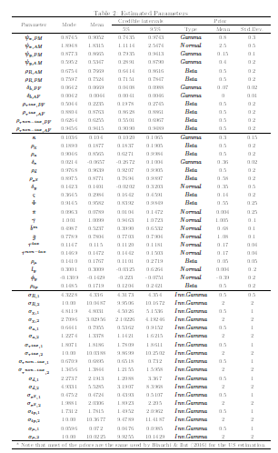
3.1 Parameter estimates (cont.)

Slide 9
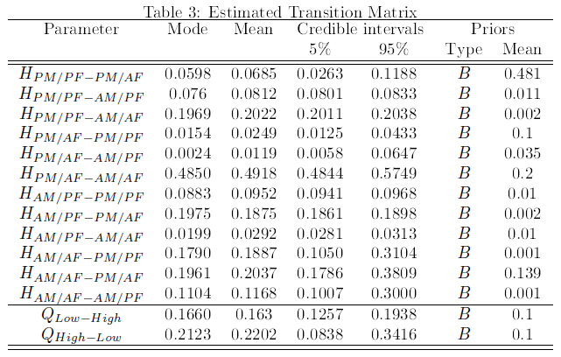
3.1 Parameter estimates (cont.)

Slide 10
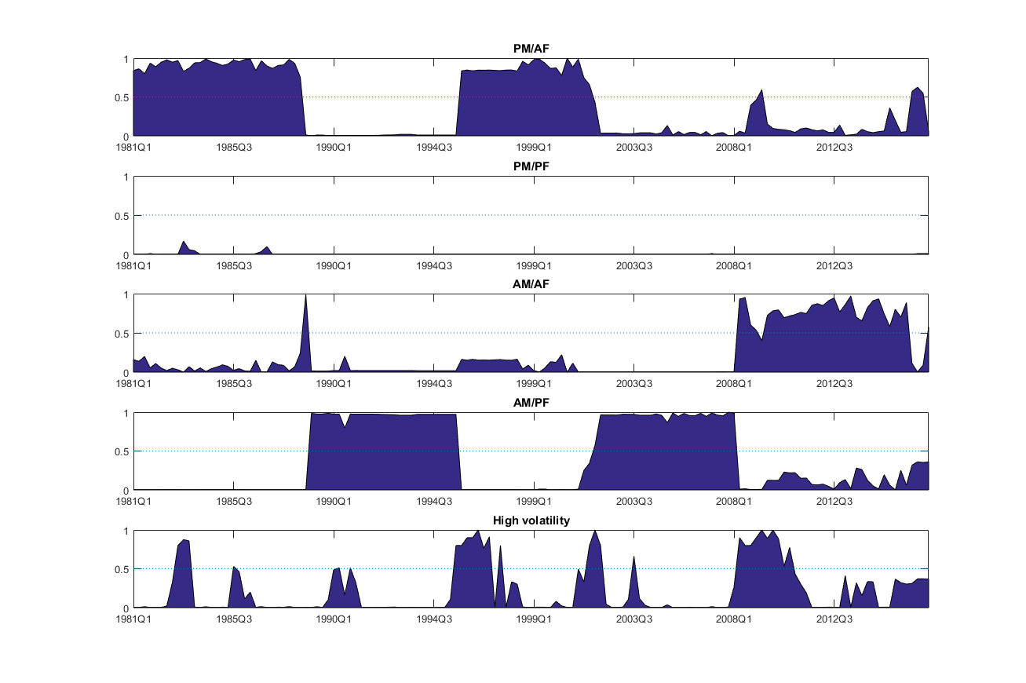
3.2 Regime probabilities

Slide 11
3.2 Mexico: historical accounts
1. 1981Q1 – 1988Q3. PM and AF.
Period of economic instability characterized by high inflation, negative ex-post real interest rates and growing public debt. Bank nationalization and debt moratorium in 1982 and disastrous earthquake in 1985.
Monetary policy: lack of central bank autonomy, high public deficits financed in part with money emission, fixed exchange rate regime, reserve requirements as the main instrument of monetary policy and weak interest rate response to inflation.
Fiscal policy: despite efforts to make expenditure adjustment through Programa Inmediato de Reordenamiento Económico, there were high deficits, elevated interest rate payments due to large and foreign denominated debt, exchange rate devaluations and low economic growth.
2. 1989Q1 – 1995Q3. AM and PF.
Pacto de Solidaridad and Estabilidad Económica efforts started taking effect, the process of structural reform deepened, inflation diminished and debt contracted. Negotiation of NAFTA, financial liberalization, bank privatization and deeper sale process of public enterprises were among the most important reforms and generated a desire to invest in the Mexican economy which led to capital inflows mostly of short-term.
Monetary policy: in 1991 exchange rate policy changed from a fixed exchange rate to a band system with a floor and a ceiling both adjustable over time. By 1994, the Constitution was reformed to grant legal autonomy to the Central Bank and it established that its main objective is to procure the stability of the purchasing power of the currency. The reform also recognized that none authority could force Central Bank to grant financing. Liquidity control through open market operations.
Fiscal policy: a drastic reduction of public expenditure reduced the public deficit. The 1989 external debt Brady Plan allowed a sharp reduction in debt. From 1991 to 1994 there were fiscal surpluses.

Slide 12
3.2 Mexico: historical accounts (cont.)
3. 1995Q4 – 2001 Q3. PM and AF.
By 1994, Mexican economy was in stress again. Political domestic events and an accumulation of imbalances in the private and external sector undermine the credibility of agents in the exchange system. Those, along with increasing international rates, produced capital outflows, and the Central Bank was not able to defend anymore the exchange rate regime as the international reserves dropped considerably. After Mexican crisis, which required a restructure of the recently reprivatized banking industry, there was international financial turbulence in Russia (1998), Brazil (1999) and Argentina (2001).
Monetary policy: floating exchange rate regime after the 1994-1995 depreciation. In 1995 Banco de México set money aggregates objectives, setting a limit in the growth of the money base and open the possibility to modify the interest rates through the balances that commercial banks had in the Central Bank in an instrument called “corto”.
Fiscal policy: the fiscal response to 1994 crisis was orthodox: adjustment in public expenditure and implementation of measures to strengthen public revenues through a tax reform that included a rise in the VAT rate from 10% to 15%. The public balance was in deficit but in modest levels. However, with the weakness of peso at the beginning of this period and the importance of foreign exchange denominated debt, the public debt increased, although later the economic growth and the fiscal measures contributed to put debt in a sustainable path.

Slide 13
3.2 Mexico: historical accounts (cont.)
4. 2001Q4 – 2008Q1. AM and PF.
Sound macroeconomic environment. Low, stable and predictable inflation. Low public deficit and public debt reached historical minimum levels as percentage of GDP.
Monetary policy: efficient implementation of an inflation targeting regime by the Central Bank in 3% (with a margin of +/-1%), credibility in the macroeconomic policy and fundamentals, change in the instruments used to implement monetary policy (from “corto” to one day interbank interest rate), transparency and more active communication from the Central Bank and relative stability in the parity peso/dollar were ingredients that allow Mexico to converge to a low, less persistent, stable and predictable level of inflation within the official target. Moreover, it was also achieved to anchor medium and long terms inflation expectations and reduce pass-through to inflation from fluctuations of the currency. Free exchange market functioned correctly and capital inflows to the developing and deepening domestic financial markets both private and public were important to the stability of Mexican currency.
Fiscal policy: Public finances were favored by high oil international prices despite low levels of tax revenues. Oil revenues concentrated around one third of public revenues in this period, but it reached 45% in 2008. Oil revenues also helped boost international reserves. The excess of oil revenues allowed public sector to increase public expenditure without deteriorating fiscal equilibrium. In 2006, it is approved the Federal Budget and Fiscal Responsibility Law (LFPRH by its Spanish acronym), which among other topics, set a zero fiscal deficit rule, forcing public expenditure to be constrained by revenue, but with the provision that deficits could be incurred in exceptional circumstances. The Law was an important step to institutionalize the management of the public finances in a responsible and predictable way. Low deficits, reasonable GDP growth, and also a change in the composition of public debt to relied more on domestic currency and in longer maturities allowed debt to follow a declining path and be more resilient to volatility in the exchange market.

Slide 14
Mexico: historical accounts (cont.)
5. 2008Q2 – 2015Q4. AM and AF.
2008/09 international financial crisis in the main trading and financial partner. Sharp drop of GDP in 2009. Reversal in terms of trade.
Monetary policy: the monetary response to the financial crisis was to reduce interest rates. However, in the following years of 2009 Mexico kept attracting capital due to the low international rates mainly in the US, confidence in the macroeconomic policy and access to the World Government Bond Index (WGBI). Although there were volatility episodes in the exchange market during and after crisis, peso was benefited from capital inflows and it was in a relative stable range between 2010 and 2014. Weakness in aggregate demand allowed Central Bank to keep low rates without provoking inflationary pressures. Inflation actually has been within the target range. In 2014 peso started a period of volatility and depreciation as some shocks showed up. Oil prices decline, uncertainty of the pace of monetary policy normalization in the US, downward revisions in the outlook of Mexico’s credit rating due to the lack of fiscal consolidation as compromised and rising debt and uncertainty about the US electoral process and potential policy implications to Mexico of the new US presidential administration were factors that led to a important and apparently permanent depreciation of peso. At the beginning, in part due to the low pass through, inflation was not compromised, but by the end of the period we are covering inflation started peaking. Anticipating this process of higher inflation, which increased its expectation, Central Bank started increasing rates at December 2015.
Fiscal policy: The fiscal authority responded to the international financial crisis with an expansionary expenditure, initially supposed to last a couple of years. The deficit relevant to fulfill the LFPRH had not been eliminated by 2016. Public revenue had positive changes in its composition. Until 2014, around one third of the public income came from oil sources and around 40% from tax sources, the oil and tax shares went to 16% and 56%, respectively in 2016. While oil revenue was impacted by the declining oil production and prices, tax proceedings were boosted because of the 2014 Tax Reform. Deficits, along with exchange rate depreciation since 2014 and low growth since 2013, led to a sizeable increase in the debt to GDP ratio: after reaching a historical minimum level in 2007, debt has continuously grown and by the end of 2016 the ratio of the broadest definition of debt was almost 100% higher than the ratio of 2007.

Slide 15
Inflation, central bank legislation, fiscal rules and fiscal councils
Average inflation | 1980-1989 | 1990-1999 | 2000-2009 | 2010-2015 | Year of new central banking legislation | Year of Inflation Targeting introduction
Brazil | 121.7 | 147.1 | 6.6 | 6.2 | No change since 1964 | 1999
Chile | 19.9 | 11.8 | 3.5 | 3.0 | 1989 | 1999
Colombia | 20.8 | 19.9 | 6.1 | 3.1 | 1992 | 1999
Mexico | 53.1 | 18.3 | 5.1 | 3.6 | 1993 | 2001
Peru | 111.0 | 78.5 | 2.6 | 3.0 | 1993 | 2002
USA | 3.1 | 3.2 | 1.8 | 2.2
 | IMF Fiscal Rules Dataset, 2016 |  |  | IMF Fiscal Council Dataset, 2017
 | Expenditure | Budget Balance | Debt
Brazil | 2000 |  | 2000
Chile |  | 2001 (2008, 2009 and 2010) |  | Advisory Fiscal Council 2014
Colombia | 2000 | 2011 |  | Comité Consultivo para la Regla Fiscal 2012
Mexico | 2013 | 2006 (2009 and 2013) |  | Centro de Estudios de las Finanzas Públicas 1998
Peru | 2000 (2003, 2012, 2013) | 2000 (2003, 2012, 2013) | 2013 | Consejo Fiscal 2015
USA | 1990 (2011, 2015) |  | 1986 (1990) | Congressional Budget Office 1974

Slide 16
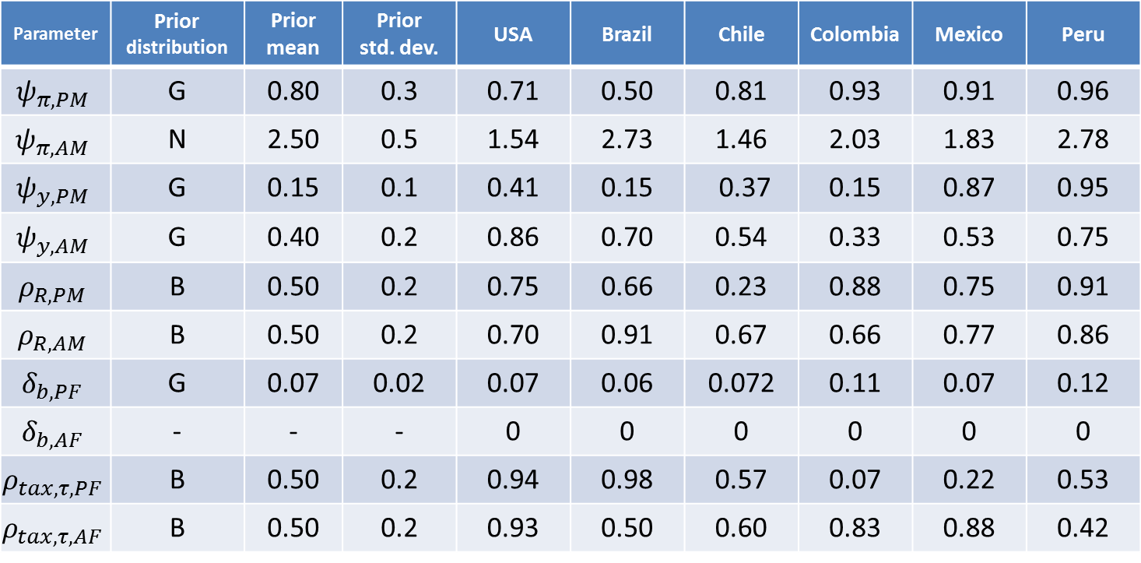
Parameter estimates
Parameter | Prior distribution | Prior mean | Prior std. dev. | USA | Brazil | Chile | Colombia | Mexico | Peru
$$ψ_{π,PM}$$ | G | 0.80 | 0.3 | 0.71 | 0.50 | 0.81 | 0.93 | 0.91 | 0.96
$$ψ_{π,AM}$$ | N | 2.50 | 0.5 | 1.54 | 2.73 | 1.46 | 2.03 | 1.83 | 2.78
$$ψ_{y,PM}$$ | G | 0.15 | 0.1 | 0.41 | 0.15 | 0.37 | 0.15 | 0.87 | 0.95
$$ψ_{y,AM}$$ | G | 0.40 | 0.2 | 0.86 | 0.70 | 0.54 | 0.33 | 0.53 | 0.75
$$ρ_{R,PM}$$ | B | 0.50 | 0.2 | 0.75 | 0.66 | 0.23 | 0.88 | 0.75 | 0.91
$$ρ_{R,AM}$$ | B | 0.50 | 0.2 | 0.70 | 0.91 | 0.67 | 0.66 | 0.77 | 0.86
$$δ_{b,PF}$$ | G | 0.07 | 0.02 | 0.07 | 0.06 | 0.072 | 0.11 | 0.07 | 0.12
$$δ_{b,AF}$$ | - | - | - | 0 | 0 | 0 | 0 | 0 | 0
$$ρ_{tax,τ,PF}$$ | B | 0.50 | 0.2 | 0.94 | 0.98 | 0.57 | 0.07 | 0.22 | 0.53
$$ρ_{tax,τ,AF}$$ | B | 0.50 | 0.2 | 0.93 | 0.50 | 0.60 | 0.83 | 0.88 | 0.42

Slide 17
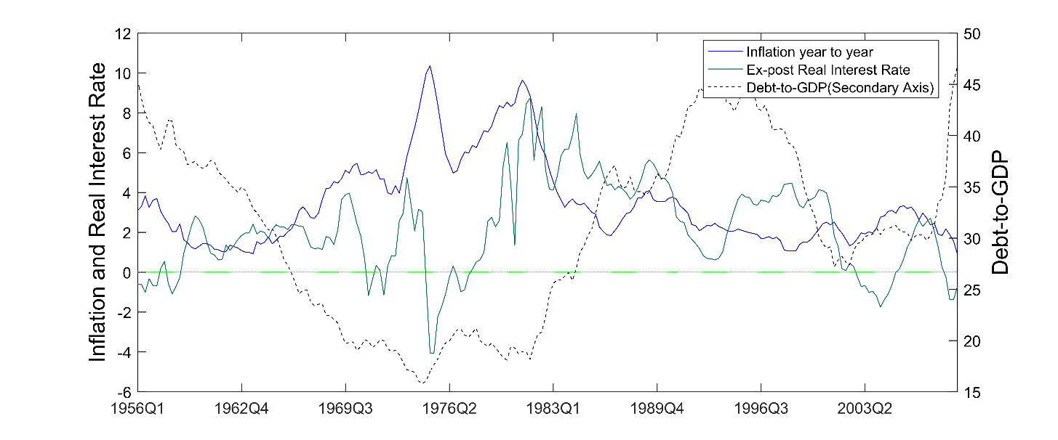
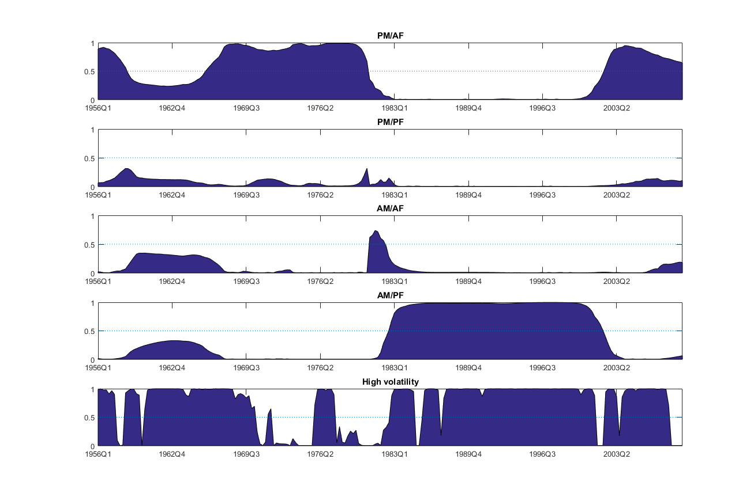
United States of America
Martin 1951
Burns 1970
Volcker 1979
Greenspan 1987
Bernanke 2006

Slide 18
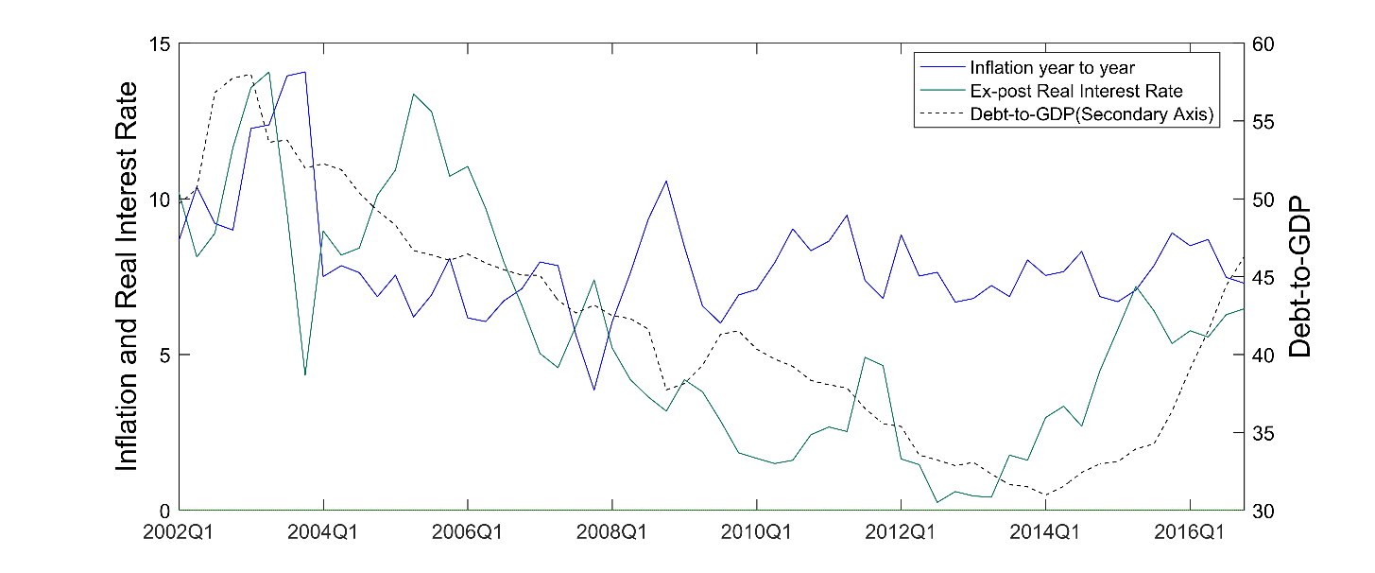
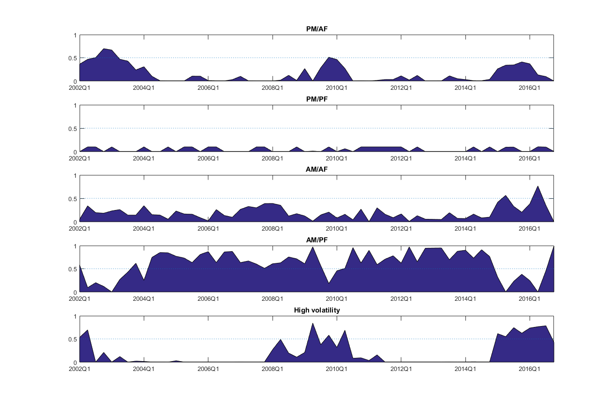
Brazil

Slide 19
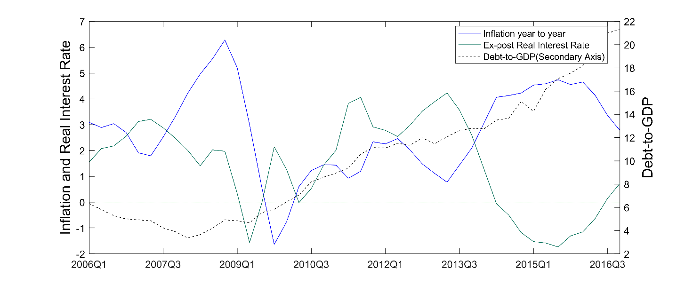
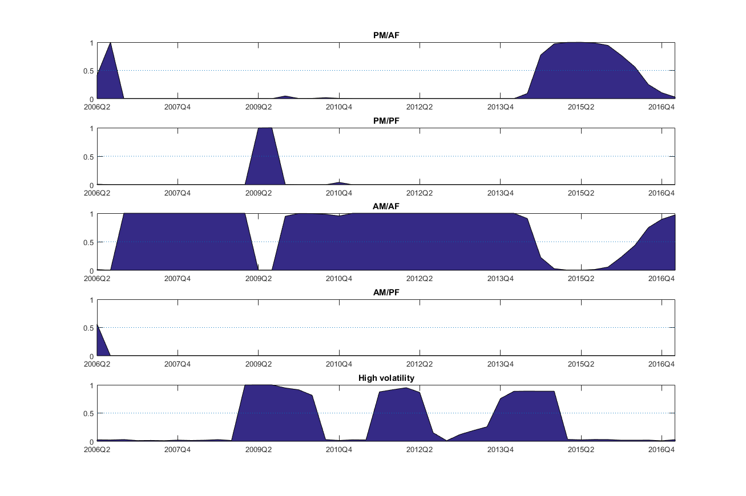
Chile

Slide 20
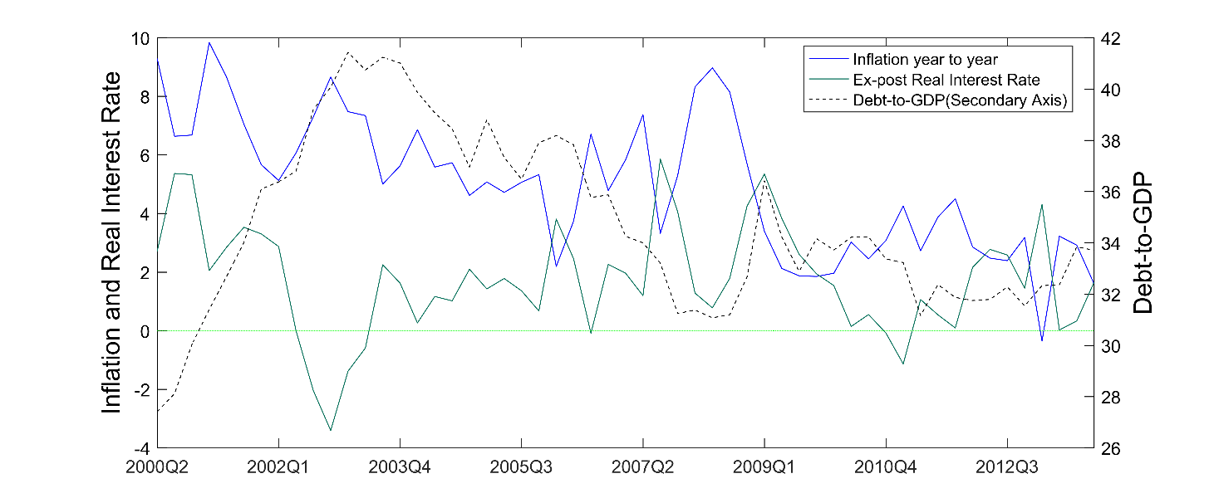
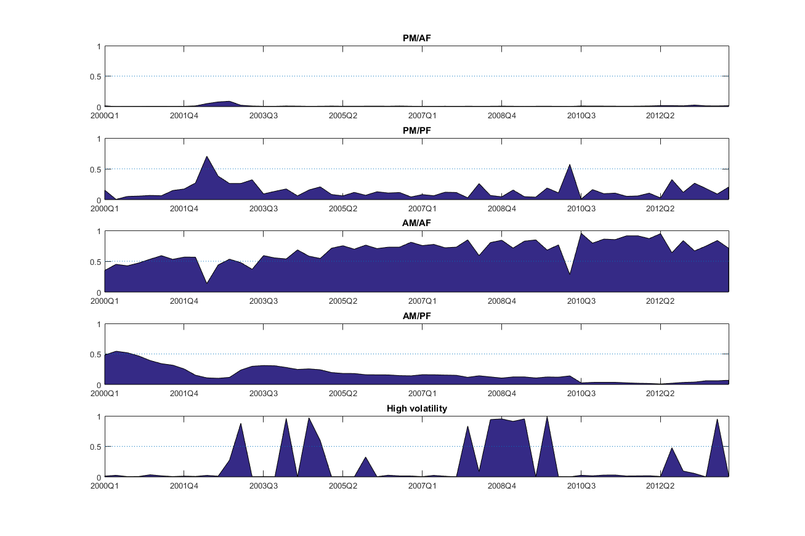
Colombia

Slide 21
Mexico

Slide 22
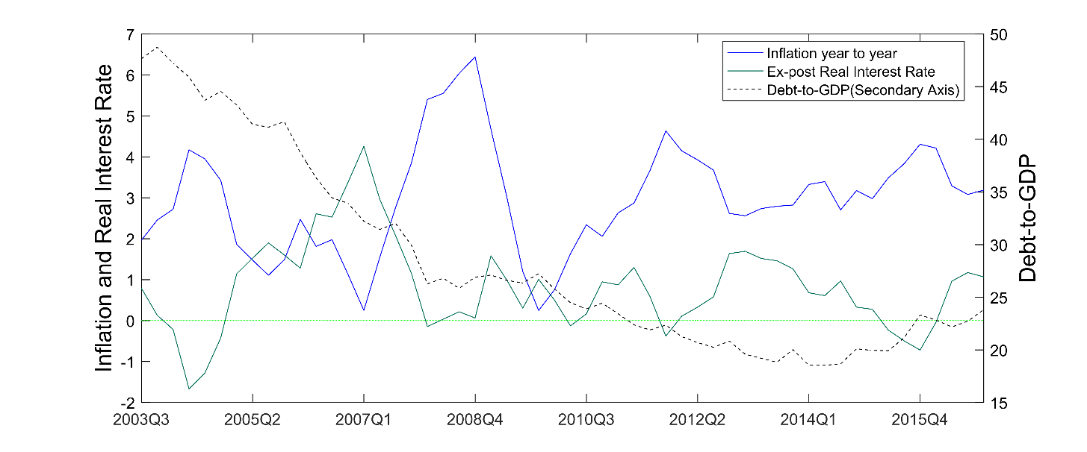
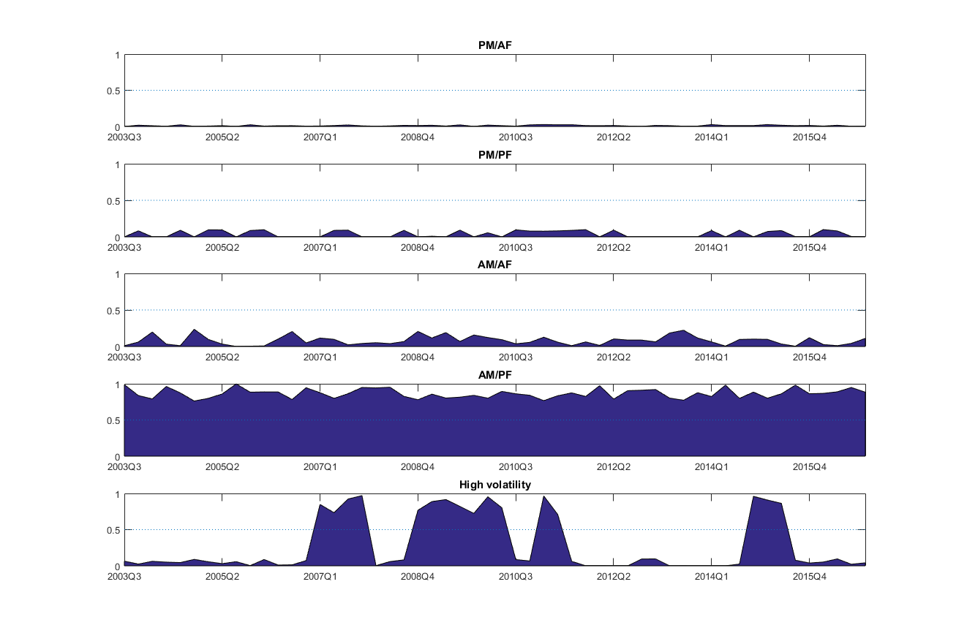
Peru

Slide 23
Did the introduction of Inflation Targeting represent a Regime Switch of Monetary Policy in Latin America?
Alberto Ortiz Bolaños

Slide 24
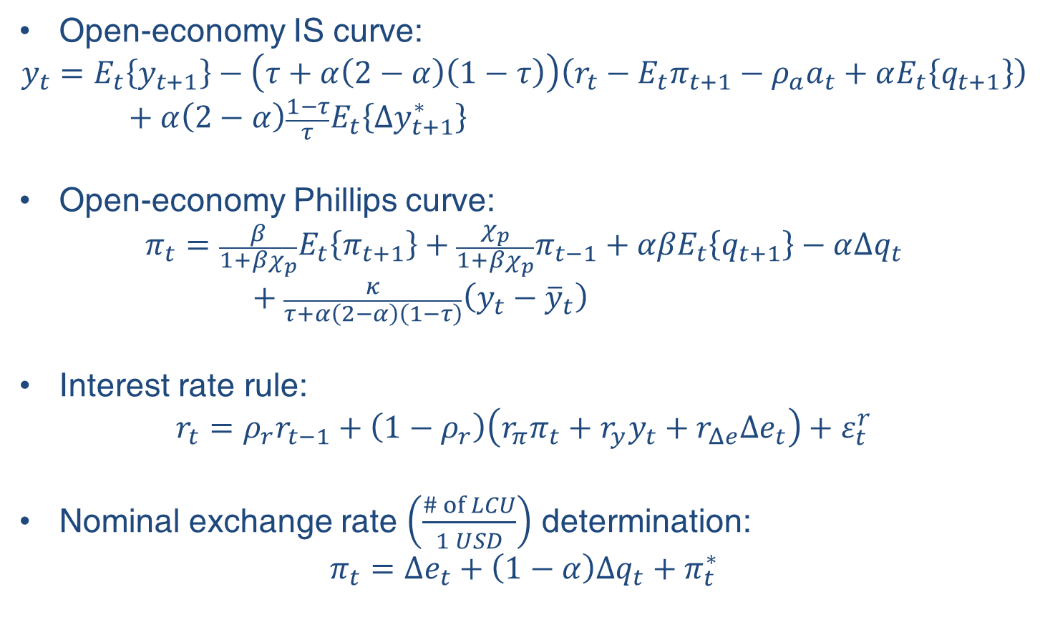
A Monetary Small Open Economy General Equilibrium Model
Open-economy IS curve:
$$y_{t}=E_{t}\left\{y_{t+1}\right\}−\left(τ+α\left(2−α\right)\left(1−τ\right)\right)\left(r_{t}−E_{t}π_{t+1}−ρ_{a}a_{t}+αE_{t}\left\{q_{t+1}\right\}\right)+α\left(2−α\right)\frac{1−τ}{τ}E_{t}\left\{Δy_{t+1}^{∗}\right\}$$
Open-economy Phillips curve:
$$π_{t}={\frac{β}{1+βχ_{p}}E}_{t}\left\{π_{t+1}\right\}+\frac{χ_{p}}{1+βχ_{p}}π_{t−1}+{αβE}_{t}\left\{q_{t+1}\right\}−α∆q_{t}+\frac{κ}{τ+α\left(2−α\right)\left(1−τ\right)}\left(y_{t}−{\overline{y}}_{t}\right)$$
Interest rate rule:
$$r_{t}=ρ_{r}r_{t−1}+\left(1−ρ_{r}\right)\left(r_{π}π_{t}+r_{y}y_{t}+r_{Δe}Δe_{t}\right)+ε_{t}^{r}$$
Nominal exchange rate $\left(\frac{\# of LCU}{1 USD}\right)$ determination:
$$π_{t}=Δe_{t}+\left(1−α\right)Δq_{t}+π_{t}^{∗}$$

Slide 25
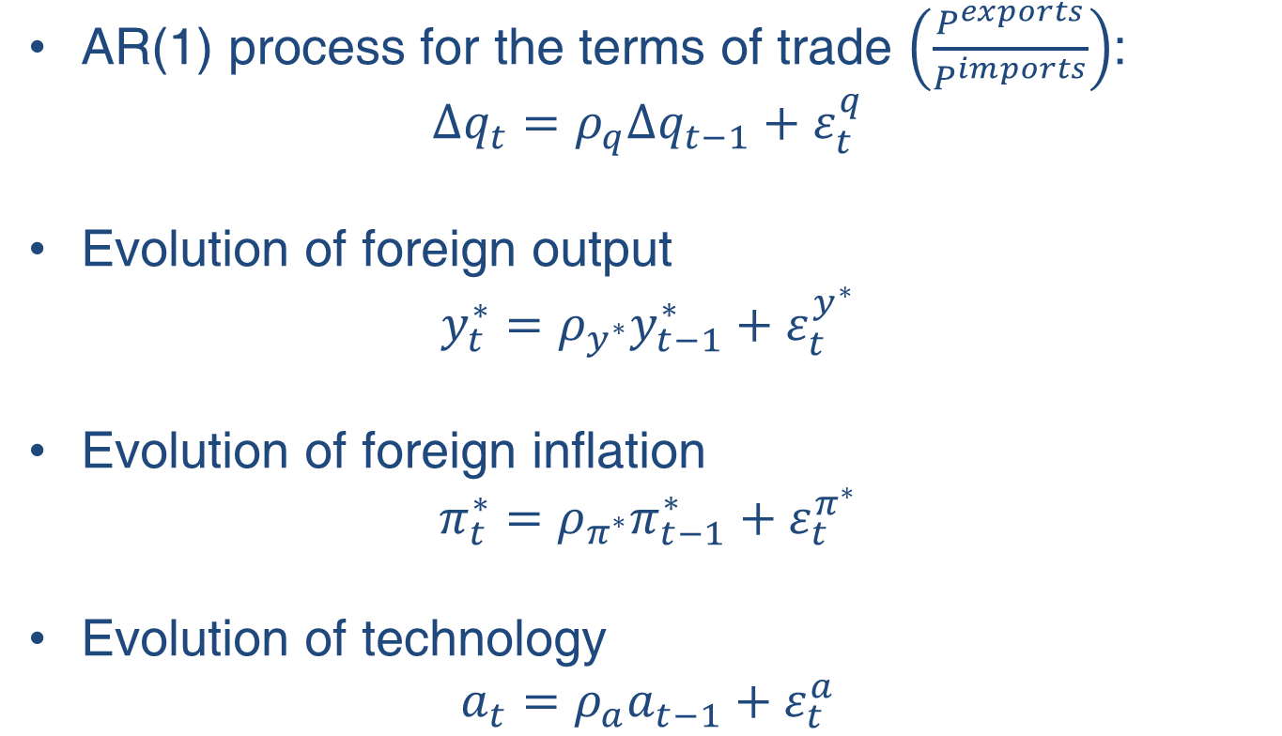
Model: External Sector and Technology
AR(1) process for the terms of trade $\left(\frac{P^{exports}}{P^{imports}}\right)$:
$$Δq_{t}=ρ_{q}Δq_{t−1}+ε_{t}^{q}$$
Evolution of foreign output
$$y_{t}^{∗}=ρ_{y^{∗}}y_{t−1}^{∗}+ε_{t}^{y^{∗}}$$
Evolution of foreign inflation
$$π_{t}^{∗}=ρ_{π^{∗}}π_{t−1}^{∗}+ε_{t}^{π^{∗}}$$
Evolution of technology
$$a_{t}=ρ_{a}a_{t−1}+ε_{t}^{a}$$

Slide 26
Empirical strategy
We estimate the previous model using macroeconomic data on inflation, interest rates, output growth, nominal exchange rate depreciation and changes in the terms of trade.
We allow for endogenous structural breaks and classify regimes according to the relative weight of inflation in an interest rate reaction function.
Parameters are allowed to vary across regimes.
These regimes might or might not be associated with the introduction or prevalence of the inflation targeting regime.
 | Exchange rate flexibility | Year of new central banking legislation | Introduction of Inflation Targeting | Sample starts
Brazil | 1999 | No change since 1964 | 1999 | 1996
Chile | 1999 | 1989 | 1999 | 1996
Colombia | 1999 | 1992 | 1999 | 1995
Mexico | 1995 | 1993 | 2001 | 1981
Peru | 2002 | 1993 | 2002 | 1995

Slide 27
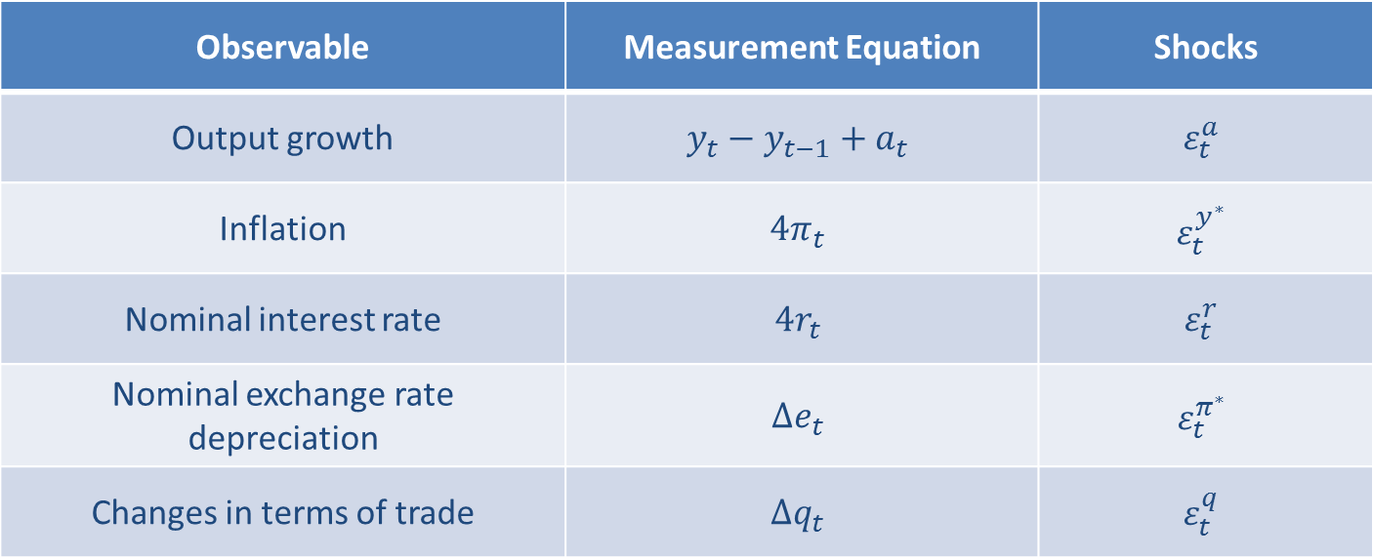
Measurement equations
Observable | Measurement Equation | Shocks
Output growth | $$y_{t}−y_{t−1}+a_{t}$$ | $$ε_{t}^{a}$$
Inflation | $$4π_{t}$$ | $$ε_{t}^{y^{∗}}$$
Nominal interest rate | $$4r_{t}$$ | $$ε_{t}^{r}$$
Nominal exchange rate depreciation | $$Δe_{t}$$ | $$ε_{t}^{π^{∗}}$$
Changes in terms of trade | $$Δq_{t}$$ | $$ε_{t}^{q}$$

Slide 28
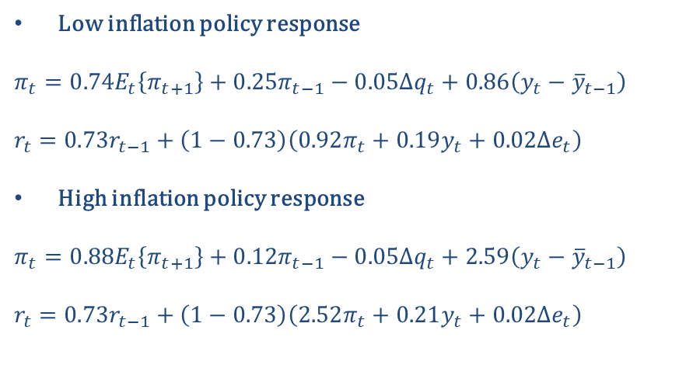
Brazil
Low inflation policy response
$$π_{t}=0.74E_{t}\left\{π_{t+1}\right\}+0.25π_{t−1}−0.05Δq_{t}+0.86\left(y_{t}−{\overline{y}}_{t−1}\right)$$
$$r_{t}=0.73r_{t−1}+\left(1−0.73\right)\left(0.92π_{t}+0.19y_{t}+0.02Δe_{t}\right)$$
High inflation policy response
$$π_{t}=0.88E_{t}\left\{π_{t+1}\right\}+0.12π_{t−1}−0.05Δq_{t}+2.59\left(y_{t}−{\overline{y}}_{t−1}\right)$$
$$r_{t}=0.73r_{t−1}+\left(1−0.73\right)\left(2.52π_{t}+0.21y_{t}+0.02Δe_{t}\right)$$
Strong shift in monetary policy during 1999 Q3 with the introduction of inflation targeting and the greater exchange rate flexibility after a 35% Real depreciation in 1999 Q1.
This was accompanied by:
  a lower persistence of inflation, or equivalently greater importance of expected inflation, in current inflation determination, and
  a stepper Phillips curve with inflation more responsive to output gap.
The analysis captures the 2002 depreciation and the Cardoso - da Silva government transition as a transitory change of the monetary policy regime from 2002 Q4 to 2003 Q3.

Slide 29
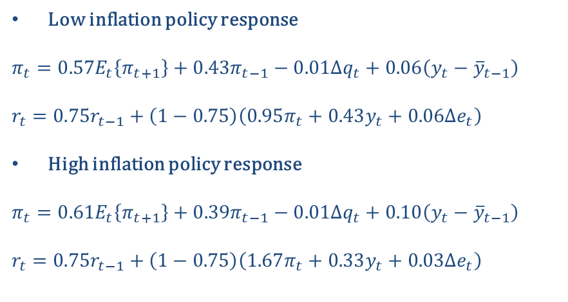
Chile
Low inflation policy response
$$π_{t}=0.57E_{t}\left\{π_{t+1}\right\}+0.43π_{t−1}−0.01Δq_{t}+0.06\left(y_{t}−{\overline{y}}_{t−1}\right)$$
$$r_{t}=0.75r_{t−1}+\left(1−0.75\right)\left(0.95π_{t}+0.43y_{t}+0.06Δe_{t}\right)$$
High inflation policy response
$$π_{t}=0.61E_{t}\left\{π_{t+1}\right\}+0.39π_{t−1}−0.01Δq_{t}+0.10\left(y_{t}−{\overline{y}}_{t−1}\right)$$
$$r_{t}=0.75r_{t−1}+\left(1−0.75\right)\left(1.67π_{t}+0.33y_{t}+0.03Δe_{t}\right)$$
Chile fully adopted inflation targeting in 1999, but as stated in Corbo et al. (2002) the scheme started to be adopted since the 1990 which is consistent with the fact that the prevailing monetary policy at the beginning of our sample, 1996, already had considerable weight in inflation. In 2006 Q4 to 2009 Q4 there was a marked shift in policy presumably with a countercyclical motive as the weight on output deviation rose during a stagflationary period.
Relatively to the other countries, Chile registers considerable more inertia in its price formation, while the Phillips curve is relatively flat across regimes.

Slide 30
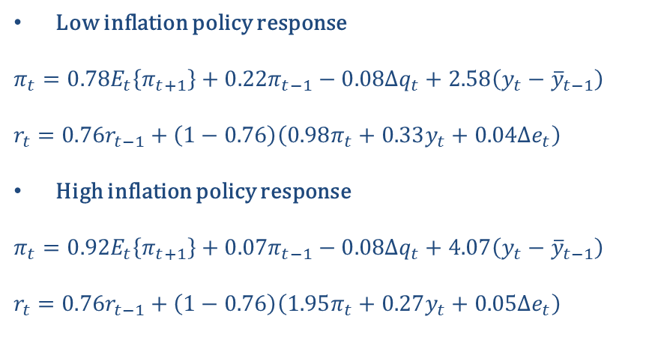
Colombia
Low inflation policy response
$$π_{t}=0.78E_{t}\left\{π_{t+1}\right\}+0.22π_{t−1}−0.08Δq_{t}+2.58\left(y_{t}−{\overline{y}}_{t−1}\right)$$
$$r_{t}=0.76r_{t−1}+\left(1−0.76\right)\left(0.98π_{t}+0.33y_{t}+0.04Δe_{t}\right)$$
High inflation policy response
$$π_{t}=0.92E_{t}\left\{π_{t+1}\right\}+0.07π_{t−1}−0.08Δq_{t}+4.07\left(y_{t}−{\overline{y}}_{t−1}\right)$$
$$r_{t}=0.76r_{t−1}+\left(1−0.76\right)\left(1.95π_{t}+0.27y_{t}+0.05Δe_{t}\right)$$
As in Brazil, Colombia experienced a strong shift in monetary policy during 1999 Q4 with the introduction of inflation targeting and greater exchange rate flexibility.
Inflation expectations gained importance in the inflation process.
The Phillips curve is steep and it became even more sensible in the regime of high policy response.

Slide 31
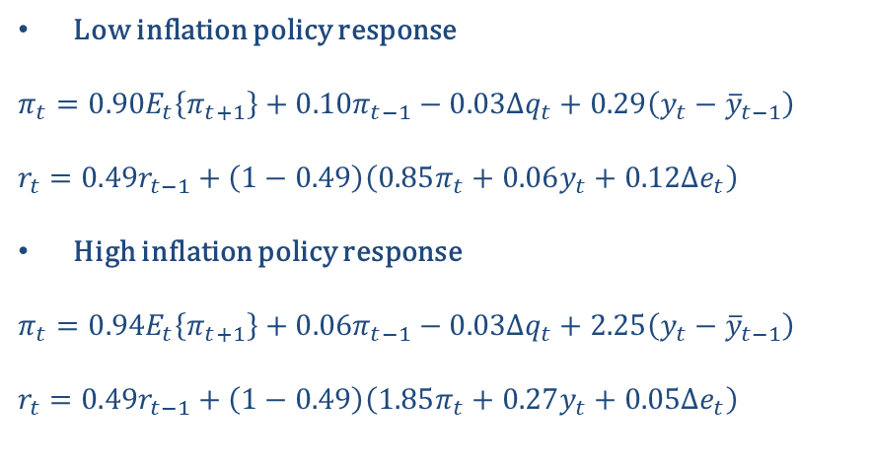
Mexico
Low inflation policy response
$$π_{t}=0.90E_{t}\left\{π_{t+1}\right\}+0.10π_{t−1}−0.03Δq_{t}+0.29\left(y_{t}−{\overline{y}}_{t−1}\right)$$
$$r_{t}=0.49r_{t−1}+\left(1−0.49\right)\left(0.85π_{t}+0.06y_{t}+0.12Δe_{t}\right)$$
High inflation policy response
$$π_{t}=0.94E_{t}\left\{π_{t+1}\right\}+0.06π_{t−1}−0.03Δq_{t}+2.25\left(y_{t}−{\overline{y}}_{t−1}\right)$$
$$r_{t}=0.49r_{t−1}+\left(1−0.49\right)\left(1.85π_{t}+0.27y_{t}+0.05Δe_{t}\right)$$
Shift in monetary policy started in 1996/7 with exchange rate floating and consolidated in 2001 with the introduction of inflation targeting.
Inflation has exhibited relatively low persistence across regimes with a considerable weight of expectations in price formation.
There is a stepper Phillips curve, with inflation more responsive to output gap, during the inflation targeting regime.

Slide 32
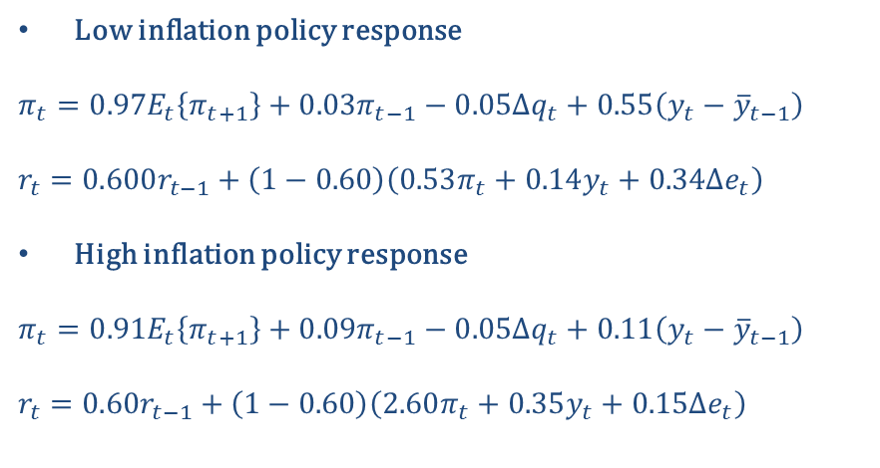
Peru
Low inflation policy response
$$π_{t}=0.97E_{t}\left\{π_{t+1}\right\}+0.03π_{t−1}−0.05Δq_{t}+0.55\left(y_{t}−{\overline{y}}_{t−1}\right)$$
$$r_{t}=0.600r_{t−1}+\left(1−0.60\right)\left(0.53π_{t}+0.14y_{t}+0.34Δe_{t}\right)$$
High inflation policy response
$$π_{t}=0.91E_{t}\left\{π_{t+1}\right\}+0.09π_{t−1}−0.05Δq_{t}+0.11\left(y_{t}−{\overline{y}}_{t−1}\right)$$
$$r_{t}=0.60r_{t−1}+\left(1−0.60\right)\left(2.60π_{t}+0.35y_{t}+0.15Δe_{t}\right)$$
After a brief episode of monetary tightening in 1998 Q4, the monetary policy towards greater responsiveness to inflation started in 2002 Q2 which coincides with the adoption of the inflation targeting regime.
Inflation is largely determined by expectations with small weight of the autoregressive component.
The relatively flat Phillips curve became less responsive in the high policy response regime.

Slide 33
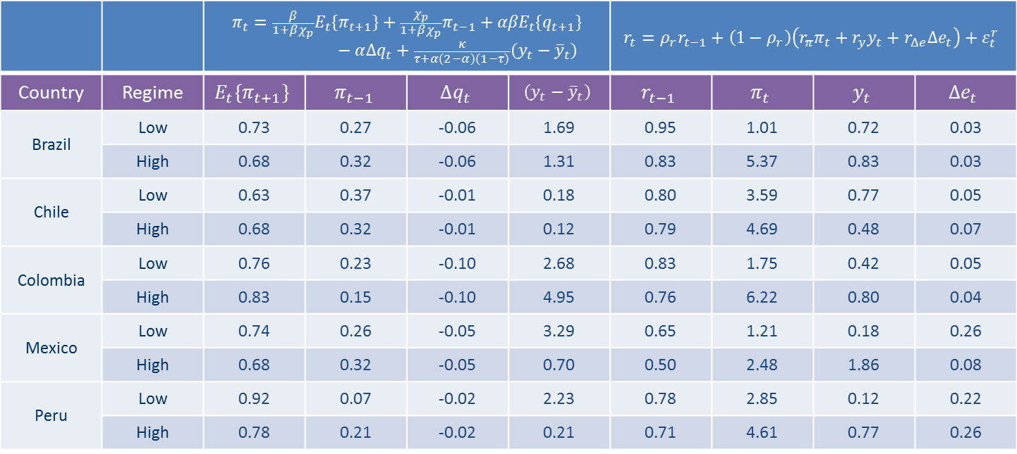
Summary of parameter estimates: low and high inflation policy response
 |  | $$π_{t}={\frac{β}{1+βχ_{p}}E}_{t}\left\{π_{t+1}\right\}+\frac{χ_{p}}{1+βχ_{p}}π_{t−1}+{αβE}_{t}\left\{q_{t+1}\right\}−α∆q_{t}+\frac{κ}{τ+α\left(2−α\right)\left(1−τ\right)}\left(y_{t}−{\overline{y}}_{t}\right)$$ |  |  |  | $$r_{t}=ρ_{r}r_{t−1}+\left(1−ρ_{r}\right)\left(r_{π}π_{t}+r_{y}y_{t}+r_{Δe}Δe_{t}\right)+ε_{t}^{r}$$
Country | Regime | $$E_{t}\left\{π_{t+1}\right\}$$ | $$π_{t−1}$$ | $$∆q_{t}$$ | $$\left(y_{t}−{\overline{y}}_{t}\right)$$ | $$r_{t−1}$$ | $$π_{t}$$ | $$y_{t}$$ | $$Δe_{t}$$
Brazil | Low | 0.73 | 0.27 | -0.06 | 1.69 | 0.95 | 1.01 | 0.72 | 0.03
 | High | 0.68 | 0.32 | -0.06 | 1.31 | 0.83 | 5.37 | 0.83 | 0.03
Chile | Low | 0.63 | 0.37 | -0.01 | 0.18 | 0.80 | 3.59 | 0.77 | 0.05
 | High | 0.68 | 0.32 | -0.01 | 0.12 | 0.79 | 4.69 | 0.48 | 0.07
Colombia | Low | 0.76 | 0.23 | -0.10 | 2.68 | 0.83 | 1.75 | 0.42 | 0.05
 | High | 0.83 | 0.15 | -0.10 | 4.95 | 0.76 | 6.22 | 0.80 | 0.04
Mexico | Low | 0.74 | 0.26 | -0.05 | 3.29 | 0.65 | 1.21 | 0.18 | 0.26
 | High | 0.68 | 0.32 | -0.05 | 0.70 | 0.50 | 2.48 | 1.86 | 0.08
Peru | Low | 0.92 | 0.07 | -0.02 | 2.23 | 0.78 | 2.85 | 0.12 | 0.22
 | High | 0.78 | 0.21 | -0.02 | 0.21 | 0.71 | 4.61 | 0.77 | 0.26
Persistence of inflation: ↑ Brazil, Mexico and Peru, ↓ Chile and Colombia.
Sensitivity of inflation to output gap: ↑ Colombia, ↔ Chile, ↓ Brasil, Mexico and Peru.

Slide 34
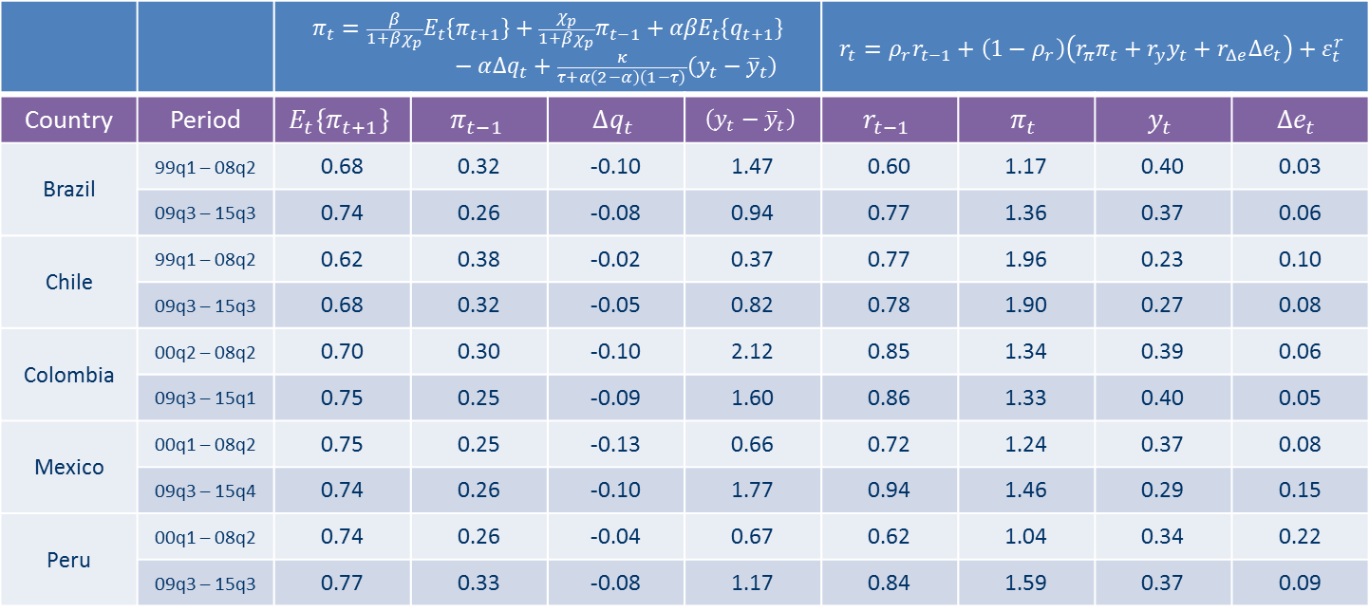
Summary of parameter estimates: pre-2008 and post-2009
 |  | $$π_{t}={\frac{β}{1+βχ_{p}}E}_{t}\left\{π_{t+1}\right\}+\frac{χ_{p}}{1+βχ_{p}}π_{t−1}+{αβE}_{t}\left\{q_{t+1}\right\}−α∆q_{t}+\frac{κ}{τ+α\left(2−α\right)\left(1−τ\right)}\left(y_{t}−{\overline{y}}_{t}\right)$$ |  |  |  | $$r_{t}=ρ_{r}r_{t−1}+\left(1−ρ_{r}\right)\left(r_{π}π_{t}+r_{y}y_{t}+r_{Δe}Δe_{t}\right)+ε_{t}^{r}$$
Country | Period | $$E_{t}\left\{π_{t+1}\right\}$$ | $$π_{t−1}$$ | $$∆q_{t}$$ | $$\left(y_{t}−{\overline{y}}_{t}\right)$$ | $$r_{t−1}$$ | $$π_{t}$$ | $$y_{t}$$ | $$Δe_{t}$$
Brazil | 99q1 – 08q2 | 0.68 | 0.32 | -0.10 | 1.47 | 0.60 | 1.17 | 0.40 | 0.03
 | 09q3 – 15q3 | 0.74 | 0.26 | -0.08 | 0.94 | 0.77 | 1.36 | 0.37 | 0.06
Chile | 99q1 – 08q2 | 0.62 | 0.38 | -0.02 | 0.37 | 0.77 | 1.96 | 0.23 | 0.10
 | 09q3 – 15q3 | 0.68 | 0.32 | -0.05 | 0.82 | 0.78 | 1.90 | 0.27 | 0.08
Colombia | 00q2 – 08q2 | 0.70 | 0.30 | -0.10 | 2.12 | 0.85 | 1.34 | 0.39 | 0.06
 | 09q3 – 15q1 | 0.75 | 0.25 | -0.09 | 1.60 | 0.86 | 1.33 | 0.40 | 0.05
Mexico | 00q1 – 08q2 | 0.75 | 0.25 | -0.13 | 0.66 | 0.72 | 1.24 | 0.37 | 0.08
 | 09q3 – 15q4 | 0.74 | 0.26 | -0.10 | 1.77 | 0.94 | 1.46 | 0.29 | 0.15
Peru | 00q1 – 08q2 | 0.74 | 0.26 | -0.04 | 0.67 | 0.62 | 1.04 | 0.34 | 0.22
 | 09q3 – 15q3 | 0.77 | 0.33 | -0.08 | 1.17 | 0.84 | 1.59 | 0.37 | 0.09
Persistence of inflation: ↑ Peru, ↔ Mexico, ↓ Brazil, Chile and Colombia.
Sensitivity of inflation to terms of trade: ↑ Chile and Peru, ↓ Brazil, Colombia and Mexico.
Sensitivity of inflation to output gap: ↑ Chile, Mexico and Peru, ↓ Brazil and Colombia.
Persistence of interest rate : ↑ Brazil, Mexico and Peru, ↔ Chile and Colombia.
Policy responsiveness to inflation: ↑ Brazil, Mexico and Peru, ↔ Colombia, ↓ Chile.

Slide 35
Did the introduction of Inflation Targeting represent a Regime Switch of Monetary Policy in Latin America? YES

Slide 36
Takeaways
Monetary policy’s effectiveness is conditioned by the fiscal stance.
Inflation targeting in the 1999-2002 period represented a regime switch for Latin American IT countries in which central banks increased their ability to control inflation.
This process was facilitated by the introduction of fiscal rules imposing restrictions on expenditure, budget balance and debt.
Positive term-of-trade shocks provided sources of revenues during the 2000s and allowed financing greater expenditure without incurring on debt.
The 2008 financial crisis required a fiscal expansion to support aggregate demand.
In some cases government expenditure exhibited high persistence, which is pressuring fiscal accounts, and this in turn complicates controlling inflation.
The institution of fiscal councils, if accompanied by legal faculties and independence, could support the needed coordination among fiscal and monetary authorities to control debt growth and inflation.

Slide 37
Good luck or good policies in Latin-American disinflations.
Construct an open-economy model with monetary and fiscal policies and estimate it using data from Latin American countries.
Our idea is to analyze the relationship between macroeconomic volatility, macroeconomic policies and inflation expectations in Brazil, Chile, Colombia, Mexico and Peru.
The analysis will use a DSGE model with fiscal and monetary factors to measure what the price formation processes have been in these countries under different fiscal and monetary/exchange rate regimes.
Emphasis will be put on the measurement of the Phillips curve with expectations and inertial components to analyze how both the volatility and the fiscal and monetary policy positions have influenced the determination of inflation.

