Slide 1
How Brazil, Chile, Colombia, Mexico and Peru have responded to terms of trade shocks during inflation targeting?
Maritsa Hernández Henao Alberto Ortiz Bolaños
CEMLA CEMLA and EGADE
jhernandez@cemla.org ortiz@cemla.org
XII Meeting of CEMLA’s Monetary Policy Managers
Madrid, Spain
June 23-24, 2016
The views expressed in this presentation are those of the authors, and not necessarily those of CEMLA.

Slide 2
Motivation
Should open-economy variables (such as exchange rates, global business cycle
conditions, or global imbalances) be part of a central bank’s monetary policy strategy?
  No necessarily.
  Clarida, Galí and Gertler (AER 2001) show that under complete exchange-rate-pass-through (producer currency pricing) and frictionless asset markets ensuring efficient risk-sharing the monetary policy design problem for the small open economy is isomorphic to the problem of the closed economy.
  As far as relative prices are not distorted, the central bank should allow for free floating of the exchange rate despite the impact of the resulting exchange variability on inflation, focusing only on output gaps and inflation.
  Likely yes.
  Corsetti and Pesenti (JME 2005) show that when firms’ markups are exposed to currency fluctuations, foreign prices increase vis-à-vis currency uncertainty reducing the purchasing power of domestic consumers. Therefore, optimal monetary rules should limit exchange rate variability.
  Corsetti, Dedola and Leduc (Handbook of Monetary Economics V3 2011) show that incomplete asset markets create policy trade-offs where optimal policies include responding to external quantities and prices.

Slide 3
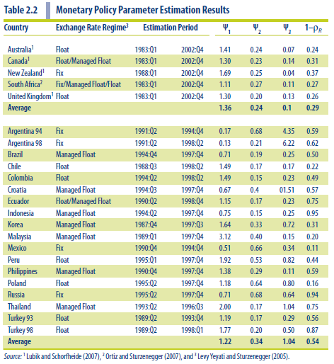
Motivation (cont.)
Are open-economy variables part of central banks’ monetary policy strategy?
$$r_{t}=ρ_{r}r_{t−1}+\left(1−ρ_{r}\right)\left(ψ_{1}π_{t}+ψ_{2}y_{t}+ψ_{3}Δe_{t}\right)+ε_{t}^{r}$$

Slide 4
Overview of the results
We explore if the nominal exchange rate or the terms-of-trade are part of central banks’ monetary policy strategy in Brazil, Chile, Colombia, Mexico and Peru since the adoption of the inflation-targeting framework.
According to the numerical exercise, Peru is the only country where the interest rate policy responds to exchange rate fluctuations. There is slight evidence that Brazilian SELIC responds to terms of trade.
An improvement in the terms of trade raises output, appreciates the currency and lowers inflation (except for Peru). These movements prompt the central banks to loosen policy.
The analysis allows us to do an historical shock decomposition to uncover the effects of different shocks, including terms of trade, on the behavior of macroeconomic variables.

Slide 5
Overview of the results (cont.)
Asymptotically, terms of trade shocks explain between 23% to 40% of nominal exchange rate fluctuations in Colombia, Mexico and Peru, but without price and asset market distortions present in the model they do not seem relevant in explaining other variables.
Newer estimations of a framework that adds fiscal policy and considers incomplete asset markets and Law-of-One-Price gap gives quantitative evidence of a larger role for terms of trade shocks.
For Colombia, asymptotically, terms of trade shocks explain 39% of output growth, 23% of interest rate movements, 66% of imported goods inflation, 6% of exchange rate movements, 15% of government expenditure, 13% of taxation, 15% of country’s indebtedness and 10% of current account movements.

Slide 6
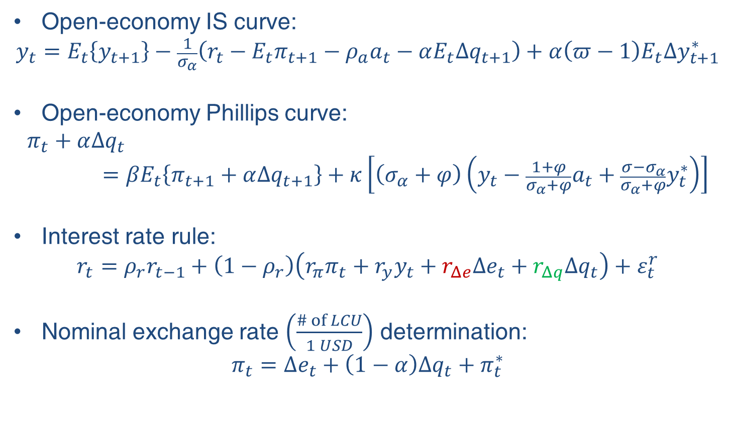
A Monetary Small Open Economy General Equilibrium Model
Open-economy IS curve:
$$y_{t}=E_{t}\left\{y_{t+1}\right\}−\frac{1}{σ_{α}}\left(r_{t}−E_{t}π_{t+1}−ρ_{a}a_{t}−αE_{t}∆q_{t+1}\right)+α\left(π−1\right)E_{t}∆y_{t+1}^{∗}$$
Open-economy Phillips curve:
$$π_{t}+α∆q_{t}={βE}_{t}\left\{π_{t+1}+α∆q_{t+1}\right\}+κ\left[\left(σ_{α}+φ\right)\left(y_{t}−{\frac{1+φ}{σ_{α}+φ}a}_{t}+\frac{{σ−σ}_{α}}{σ_{α}+φ}y_{t}^{∗}\right)\right]$$
Interest rate rule:
$$r_{t}=ρ_{r}r_{t−1}+\left(1−ρ_{r}\right)\left(r_{π}π_{t}+r_{y}y_{t}+r_{Δe}Δe_{t}+r_{Δq}Δq_{t}\right)+ε_{t}^{r}$$
Nominal exchange rate $\left(\frac{\# of LCU}{1 USD}\right)$ determination:
$$π_{t}=Δe_{t}+\left(1−α\right)Δq_{t}+π_{t}^{∗}$$

Slide 7
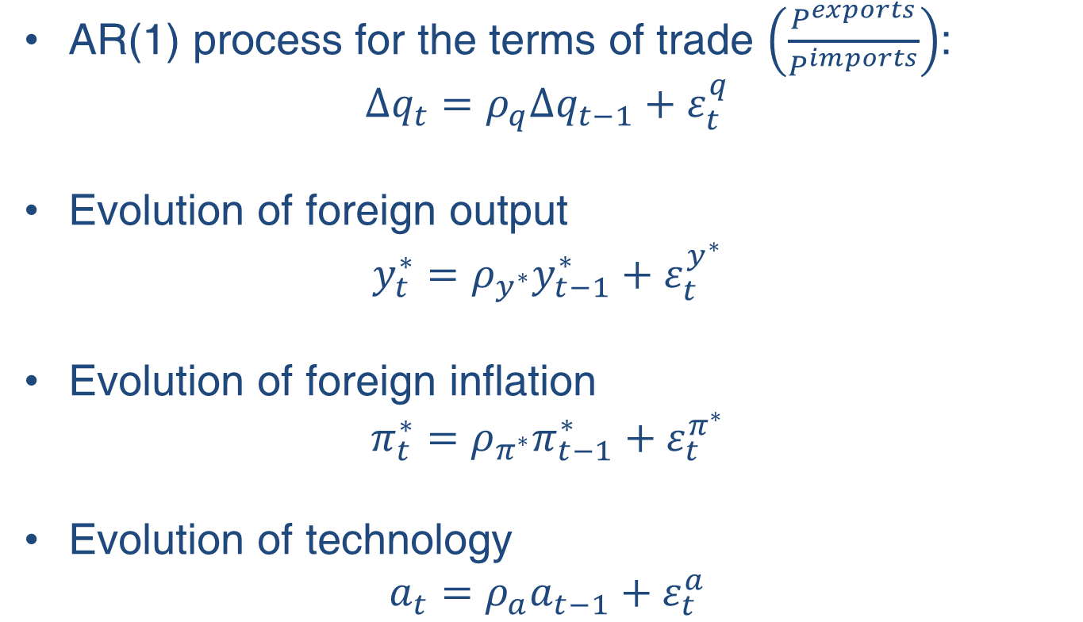
Model: External Sector and Technology
AR(1) process for the terms of trade $\left(\frac{P^{exports}}{P^{imports}}\right)$:
$$Δq_{t}=ρ_{q}Δq_{t−1}+ε_{t}^{q}$$
Evolution of foreign output
$$y_{t}^{∗}=ρ_{y^{∗}}y_{t−1}^{∗}+ε_{t}^{y^{∗}}$$
Evolution of foreign inflation
$$π_{t}^{∗}=ρ_{π^{∗}}π_{t−1}^{∗}+ε_{t}^{π^{∗}}$$
Evolution of technology
$$a_{t}=ρ_{a}a_{t−1}+ε_{t}^{a}$$

Slide 8
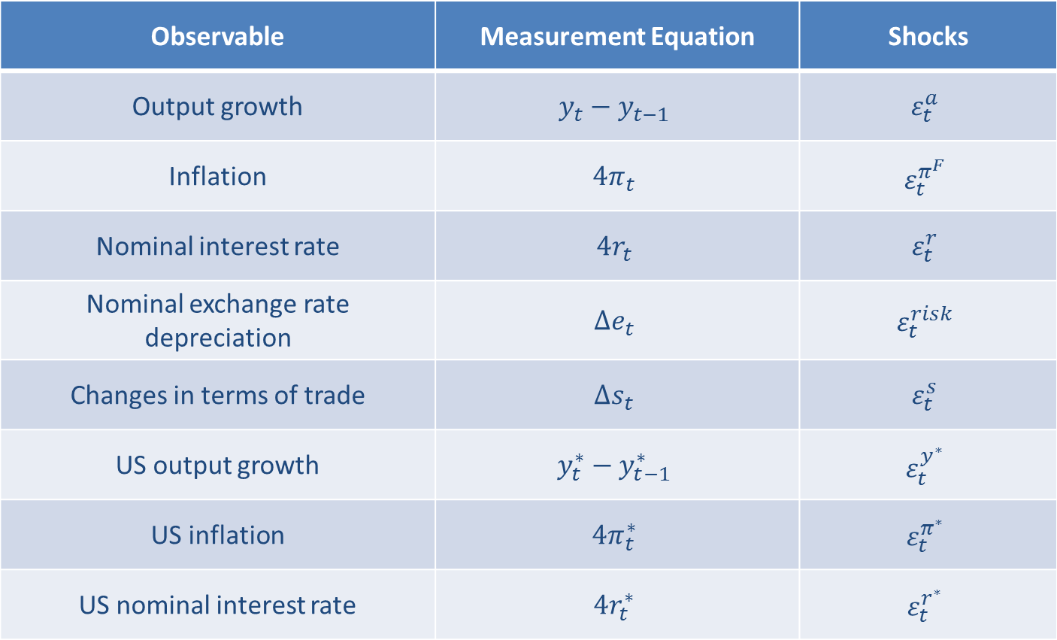
Measurement equations
Observable | Measurement Equation | Shocks
Output growth | $$y_{t}−y_{t−1}$$ | $$ε_{t}^{a}$$
Inflation | $$4π_{t}$$ | $$ε_{t}^{π^{F}}$$
Nominal interest rate | $$4r_{t}$$ | $$ε_{t}^{r}$$
Nominal exchange rate depreciation | $$Δe_{t}$$ | $$ε_{t}^{risk}$$
Changes in terms of trade | $$Δs_{t}$$ | $$ε_{t}^{s}$$
US output growth | $$y_{t}^{∗}−y_{t−1}^{∗}$$ | $$ε_{t}^{y^{∗}}$$
US inflation | $$4π_{t}^{∗}$$ | $$ε_{t}^{π^{∗}}$$
US nominal interest rate | $$4r_{t}^{∗}$$ | $$ε_{t}^{r^{∗}}$$

Slide 9
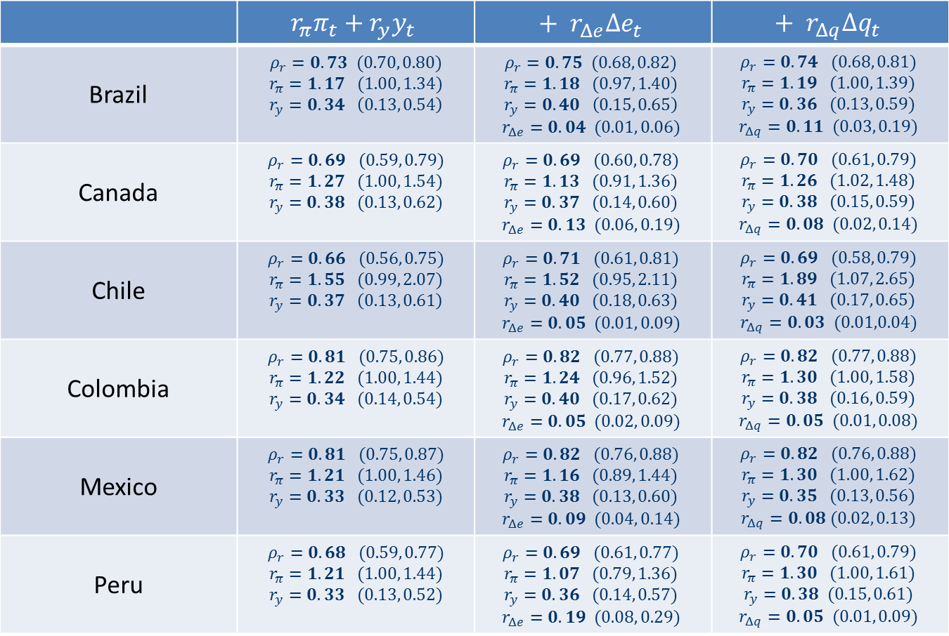
Monetary policy rules
 | $$r_{π}π_{t}+r_{y}y_{t}$$ | $$+ r_{Δe}Δe_{t}$$ | $$+ r_{Δq}Δq_{t}$$
Brazil | $$ρ_{r}=0.73 (0.70, 0.80)$$ $$r_{π}=1.17 (1.00, 1.34)$$ $$r_{y}=0.34 \left(0.13, 0.54\right)$$ | $$ρ_{r}=0.75 (0.68, 0.82)$$ $$r_{π}=1.18 (0.97, 1.40)$$ $$r_{y}=0.40 \left(0.15, 0.65\right)$$ $$r_{Δe}=0.04 (0.01, 0.06)$$ | $$ρ_{r}=0.74 (0.68, 0.81)$$ $$r_{π}=1.19 (1.00, 1.39)$$ $$r_{y}=0.36 (0.13, 0.59)$$ $$r_{Δq}=0.11 (0.03, 0.19)$$
Canada | $$ρ_{r}=0.69 (0.59, 0.79)$$ $$r_{π}=1.27 (1.00, 1.54)$$ $$r_{y}=0.38 (0.13, 0.62)$$ | $$ρ_{r}=0.69 (0.60, 0.78)$$ $$r_{π}=1.13 (0.91, 1.36)$$ $$r_{y}=0.37 (0.14, 0.60)$$ $$r_{Δe}=0.13 (0.06, 0.19)$$ | $$ρ_{r}=0.70 (0.61, 0.79)$$ $$r_{π}=1.26 (1.02, 1.48)$$ $$r_{y}=0.38 (0.15, 0.59)$$ $$r_{Δq}=0.08 (0.02, 0.14)$$
Chile | $$ρ_{r}=0.66 (0.56, 0.75)$$ $$r_{π}=1.55 (0.99, 2.07)$$ $$r_{y}=0.37 \left(0.13, 0.61\right)$$ | $$ρ_{r}=0.71 (0.61, 0.81)$$ $$r_{π}=1.52 (0.95, 2.11)$$ $$r_{y}=0.40 (0.18, 0.63)$$ $$r_{Δe}=0.05 (0.01, 0.09)$$ | $$ρ_{r}=0.69 (0.58, 0.79)$$ $$r_{π}=1.89 (1.07, 2.65)$$ $$r_{y}=0.41 (0.17, 0.65)$$ $$r_{Δq}=0.03 (0.01,0.04)$$
Colombia | $$ρ_{r}=0.81 (0.75, 0.86)$$ $$r_{π}=1.22 (1.00, 1.44)$$ $$r_{y}=0.34 (0.14, 0.54)$$ | $$ρ_{r}=0.82 (0.77, 0.88)$$ $$r_{π}=1.24 (0.96, 1.52)$$ $$r_{y}=0.40 (0.17, 0.62)$$ $$r_{Δe}=0.05 (0.02, 0.09)$$ | $$ρ_{r}=0.82 (0.77, 0.88)$$ $$r_{π}=1.30 (1.00, 1.58)$$ $$r_{y}=0.38 (0.16, 0.59)$$ $$r_{Δq}=0.05 (0.01, 0.08)$$
Mexico | $$ρ_{r}=0.81 (0.75, 0.87)$$ $$r_{π}=1.21 (1.00, 1.46)$$ $$r_{y}=0.33 (0.12, 0.53)$$ | $$ρ_{r}=0.82 (0.76, 0.88)$$ $$r_{π}=1.16 (0.89, 1.44)$$ $$r_{y}=0.38 (0.13, 0.60)$$ $$r_{Δe}=0.09 (0.04, 0.14)$$ | $$ρ_{r}=0.82 (0.76, 0.88)$$ $$r_{π}=1.30 (1.00, 1.62)$$ $$r_{y}=0.35 (0.13, 0.56)$$ $$r_{Δq}=0.08 (0.02, 0.13)$$
Peru | $$ρ_{r}=0.68 (0.59, 0.77)$$ $$r_{π}=1.21 (1.00, 1.44)$$ $$r_{y}=0.33 (0.13, 0.52)$$ | $$ρ_{r}=0.69 (0.61, 0.77)$$ $$r_{π}=1.07 (0.79, 1.36)$$ $$r_{y}=0.36 (0.14, 0.57)$$ $$r_{Δe}=0.19 (0.08, 0.29)$$ | $$ρ_{r}=0.70 (0.61, 0.79)$$ $$r_{π}=1.30 (1.00, 1.61)$$ $$r_{y}=0.38 (0.15, 0.61)$$ $$r_{Δq}=0.05 (0.01, 0.09)$$

Slide 10
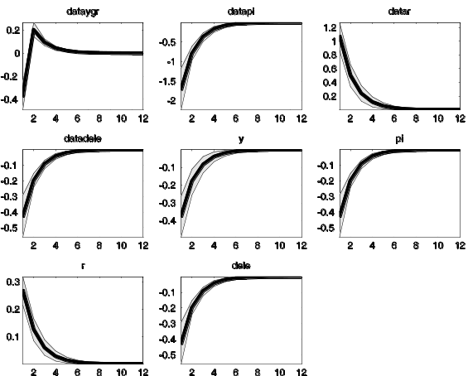
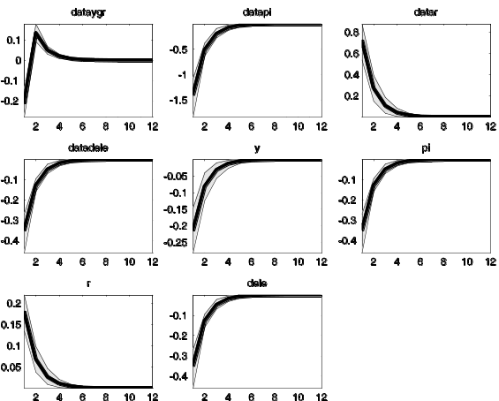
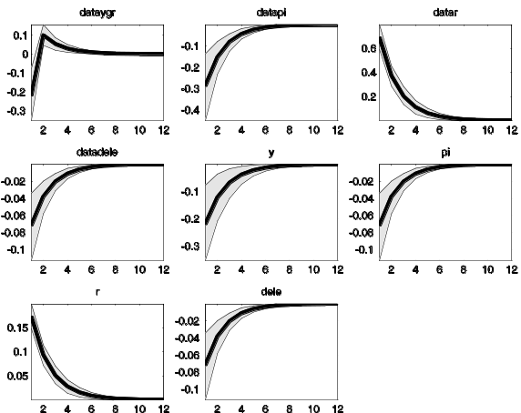
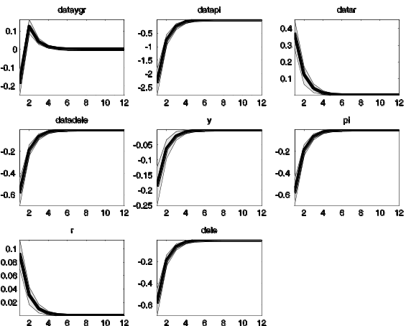
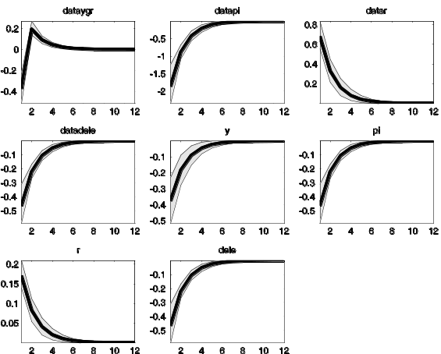
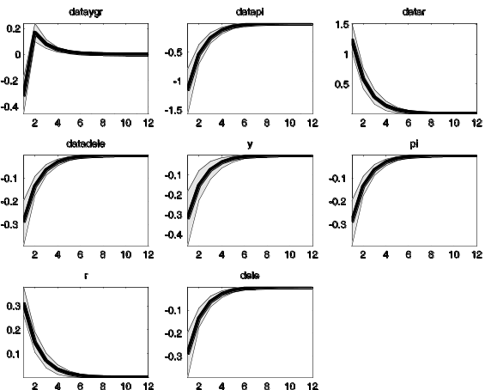
Monetary Policy
A contractionary monetary policy appreciates
the currency and lowers inflation and output.
Brazil
Canada
Chile
Colombia
Mexico
Peru

Slide 11
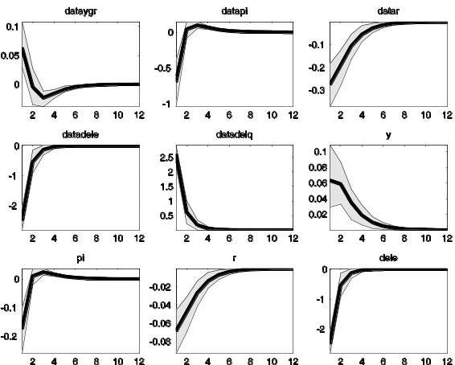
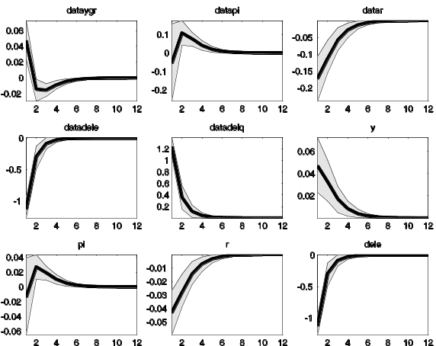
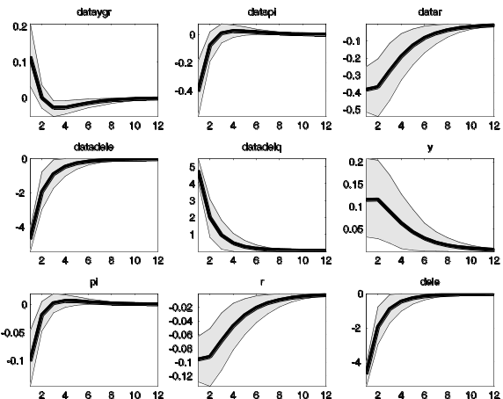
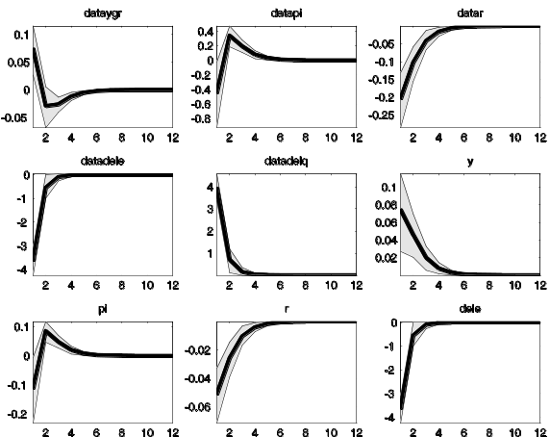
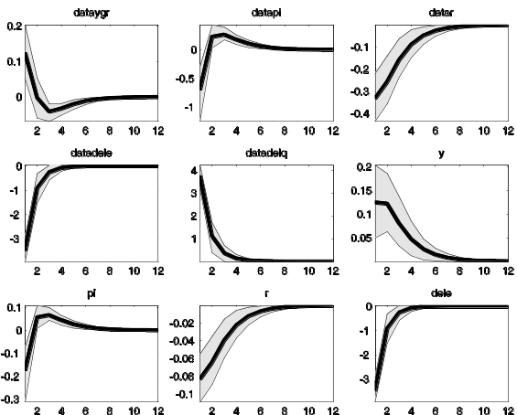
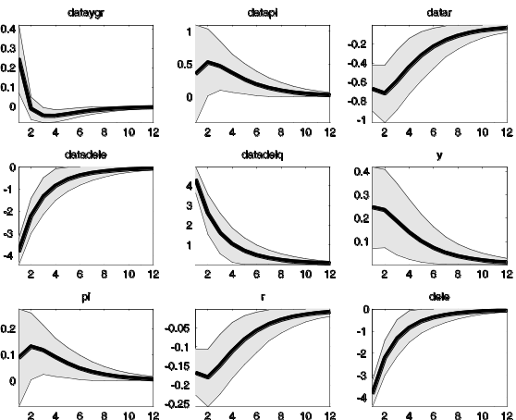
Terms of trade
An improvement in the terms of trade raises output,
appreciates the currency and lowers inflation (except
for Peru). These movements prompt the central
banks to loosen policy.
Brazil
Canada
Chile
Colombia
Mexico
Peru

Slide 12
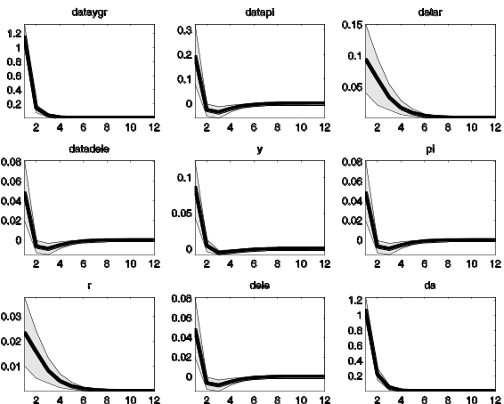
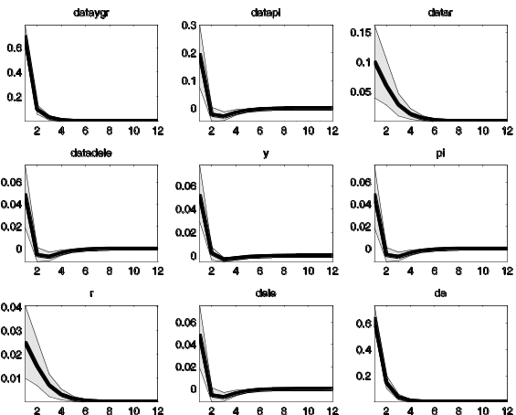
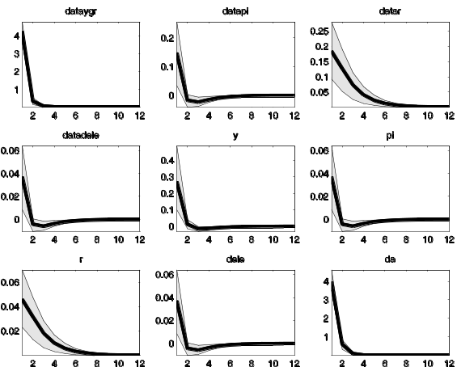
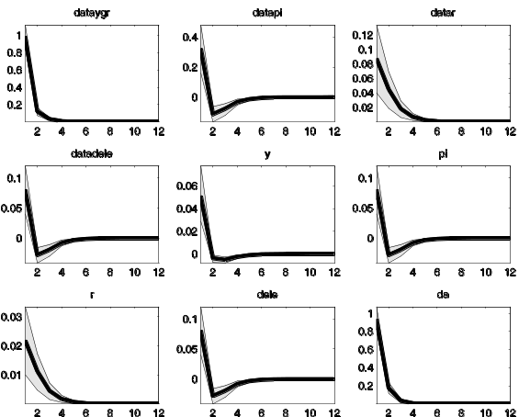
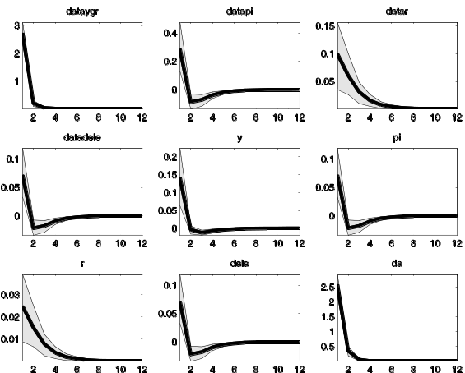
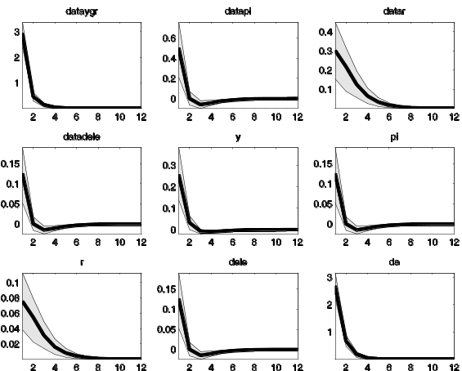
Technology
Technology is assumed to be difference stationary,
so productivity innovations have permanent effects
on output.
Brazil
Canada
Chile
Colombia
Mexico
Peru

Slide 13
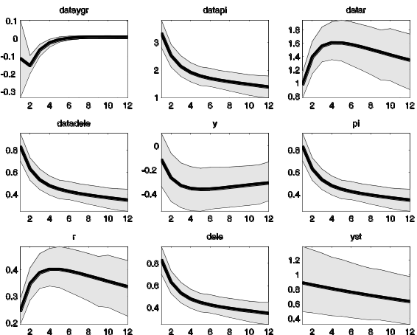
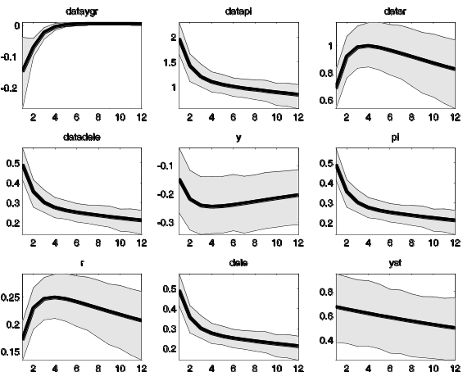
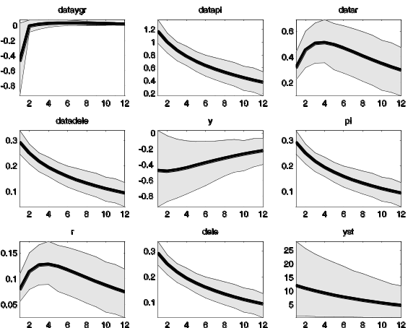
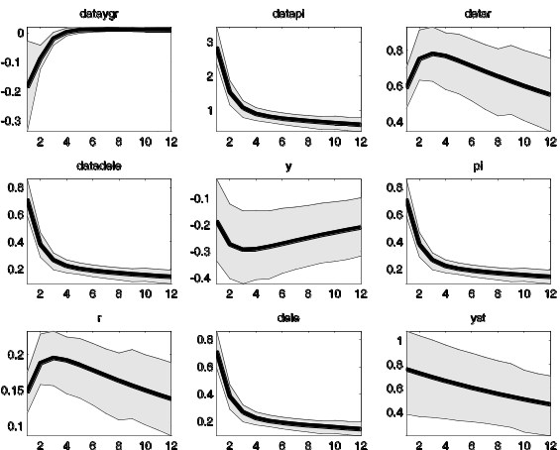
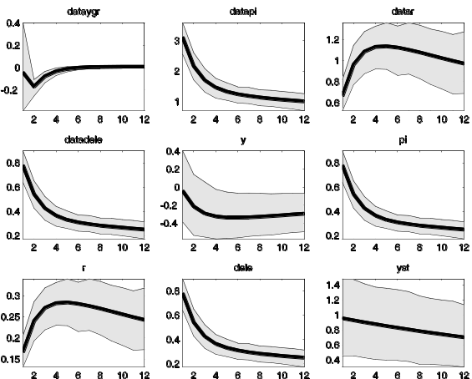
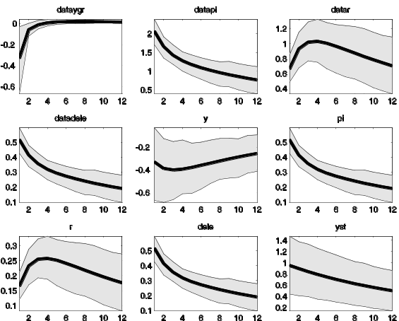
World Output
World demand shocks lowers domestic output along with an increase in
inflation and an exchange rate depreciation. This result arises since, under
the estimated elasticity of intertemporal substitution, world output shocks
lower domestic potential output. This prompts the central bank to raise rates.
Brazil
Canada
Chile
Colombia
Mexico
Peru

Slide 14
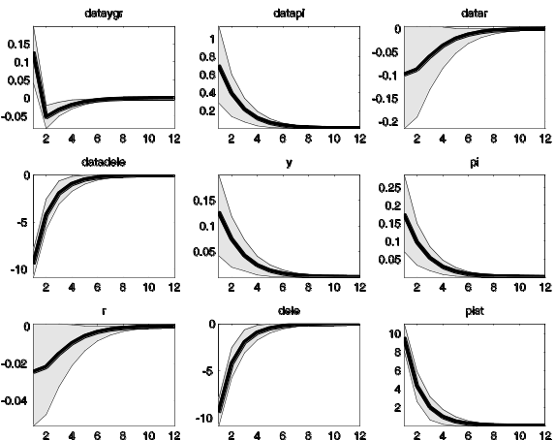
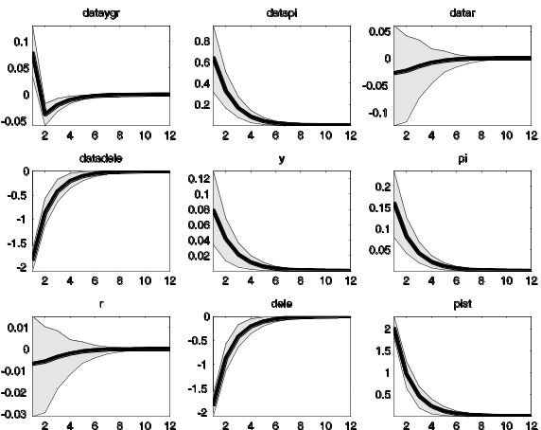
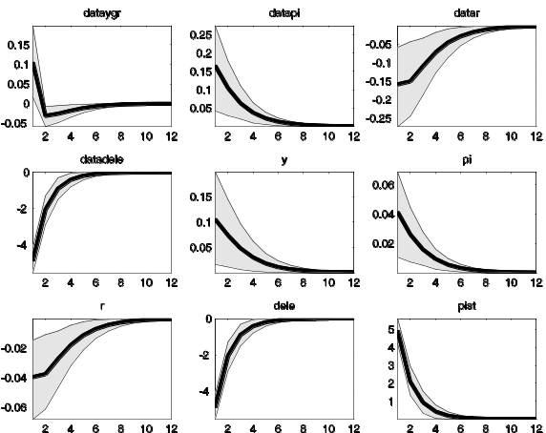
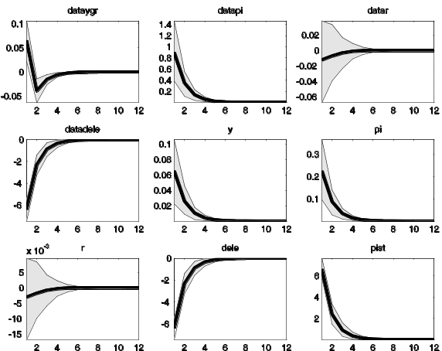
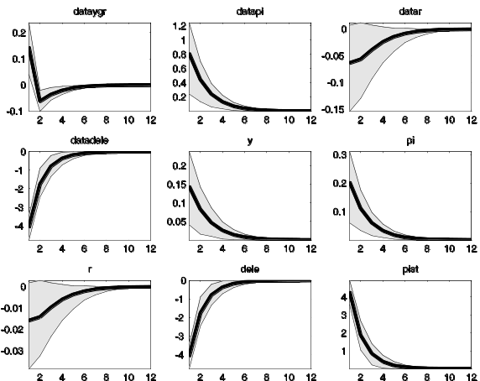
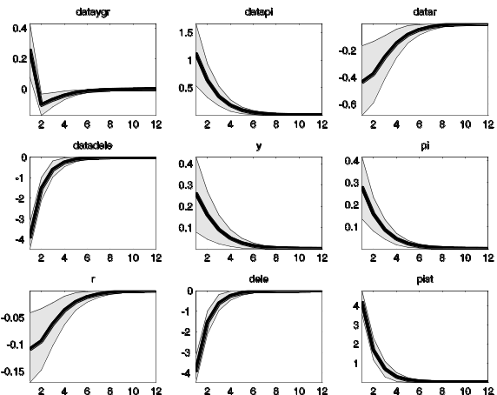
World Inflation
Shocks to import price inflation appreciate the currency,
but raise inflation since the central bank reacts to
movements in the exchange rate and lowers rates.
Brazil
Canada
Chile
Colombia
Mexico
Peru

Slide 15
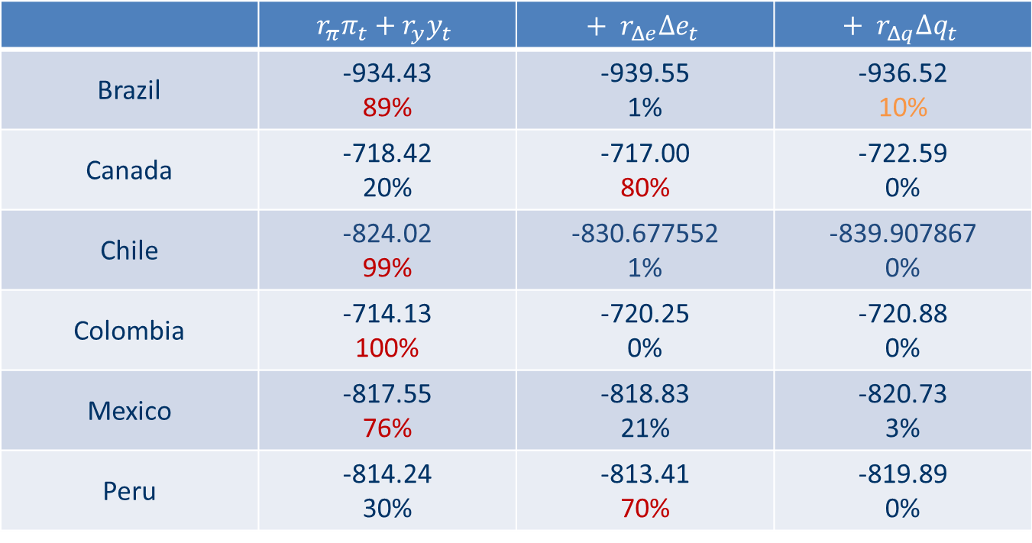
Models’ fit comparison
The following table shows the Log Data Density of the model with three alternative monetary policy rules:
 | $$r_{π}π_{t}+r_{y}y_{t}$$ | $$+ r_{Δe}Δe_{t}$$ | $$+ r_{Δq}Δq_{t}$$
Brazil | -934.43 89% | -939.55 1% | -936.52 10%
Canada | -718.42 20% | -717.00 80% | -722.59 0%
Chile | -824.02 99% | -830.677552 1% | -839.907867 0%
Colombia | -714.13 100% | -720.25 0% | -720.88 0%
Mexico | -817.55 76% | -818.83 21% | -820.73 3%
Peru | -814.24 30% | -813.41 70% | -819.89 0%

Slide 16
Historical contribution of terms of trade shocks: output (% deviations from steady-state)

Slide 17
Historical contribution of terms of trade shocks: output (% deviations from steady-state)

Slide 18
Historical contribution of terms of trade shocks: inflation (% deviations from steady-state)

Slide 19
Historical contribution of terms of trade shocks: inflation (% deviations from steady-state)

Slide 20
Historical contribution of terms of trade shocks: interest rate (% deviations from steady-state)

Slide 21
Historical contribution of terms of trade shocks: interest rate (% deviations from steady-state)

Slide 22
Historical contribution of terms of trade shocks: exchange rate depreciation

Slide 23
Historical contribution of terms of trade shocks: exchange rate depreciation

Slide 24
Variance decomposition
Monetary | Output growth | Inflation | Interest rates | Exchange rate
Brazil | 5.6 | 4.7 | 2.8 | 0.1
Canada | 13.1 | 8.0 | 2.7 | 1.5
Chile | 0.2 | 4.8 | 32 | 0.0
Colombia | 5.6 | 16.4 | 1.3 | 0.7
Mexico | 2.8 | 29.0 | 11.7 | 1.1
Peru | 2.0 | 14.8 | 25.9 | 0.3
Terms of trade | Output growth | Inflation | Interest rates | Exchange rate
Brazil | 0.2 | 1.9 | 0.4 | 7.2
Canada | 0.1 | 0.4 | 0.1 | 16.1
Chile | 0.0 | 15.6 | 7.3 | 37.5
Colombia | 0.5 | 2.1 | 0.4 | 23.1
Mexico | 0.1 | 6.2 | 1.5 | 37.9
Peru | 0.1 | 5.9 | 2.6 | 39.0

Slide 25
Variance decomposition
Technology | Output growth | Inflation | Interest rates | Exchange rate
Brazil | 92.1 | 0.2 | 0.1 | 0.0
Canada | 76.7 | 0.1 | 0.1 | 0.1
Chile | 97.4 | 2.3 | 5.1 | 0.0
Colombia | 83.8 | 0.3 | 0.1 | 0.1
Mexico | 96.8 | 0.6 | 0.3 | 0.0
Peru | 96.1 | 1.5 | 1.3 | 0.1

Slide 26
Variance decomposition
World output | Output growth | Inflation | Interest rates | Exchange rate
Brazil | 2.1 | 93.3 | 96.7 | 4.3
Canada | 10.2 | 91.5 | 97.1 | 25.8
Chile | 2.4 | 77.2 | 55.5 | 1.5
Colombia | 10.1 | 81.1 | 98.3 | 4.7
Mexico | 0.4 | 64.2 | 86.6 | 3.4
Peru | 1.9 | 77.9 | 70.2 | 2.4
World inflation | Output growth | Inflation | Interest rates | Exchange rate
Brazil | 0.0 | 0.0 | 0.0 | 88.3
Canada | 0.0 | 0.0 | 0.0 | 56.5
Chile | 0.0 | 0.0 | 0.0 | 61.0
Colombia | 0.0 | 0.0 | 0.0 | 71.4
Mexico | 0.0 | 0.0 | 0.0 | 57.6
Peru | 0.0 | 0.0 | 0.0 | 58.3

Slide 27
Remarks
This is work in progress and the goal is to have a country by country analysis of the cyclicality of their macroeconomic policies and the effect that different domestic and external shocks have in explaining their business cycle fluctuations.
All comments or suggestions are greatly appreciated.

Slide 28
How Brazil, Chile, Colombia, Mexico and Peru have responded to terms of trade shocks during inflation targeting?
Maritsa Hernández Henao Alberto Ortiz Bolaños
CEMLA CEMLA and EGADE
jhernandez@cemla.org ortiz@cemla.org
Thank you!

