Slide 1
Monetary and Fiscal Policies in Latin America:
Evidence from an Estimated DSGE Model
Maritsa Hernández Henao Alberto Ortiz Bolaños
CEMLA CEMLA and EGADE
XX Meeting of CEMLA’s Research Network
Santo Domingo, República Dominicana
November 26, 2015

Slide 2
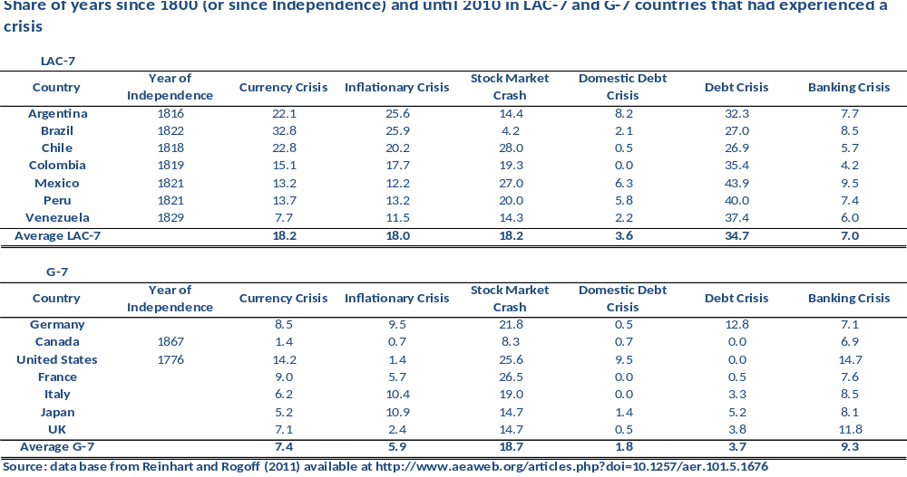
Motivation
In LAC-7, combination of weak economic fundamentals and/or adverse external conditions.

Slide 3
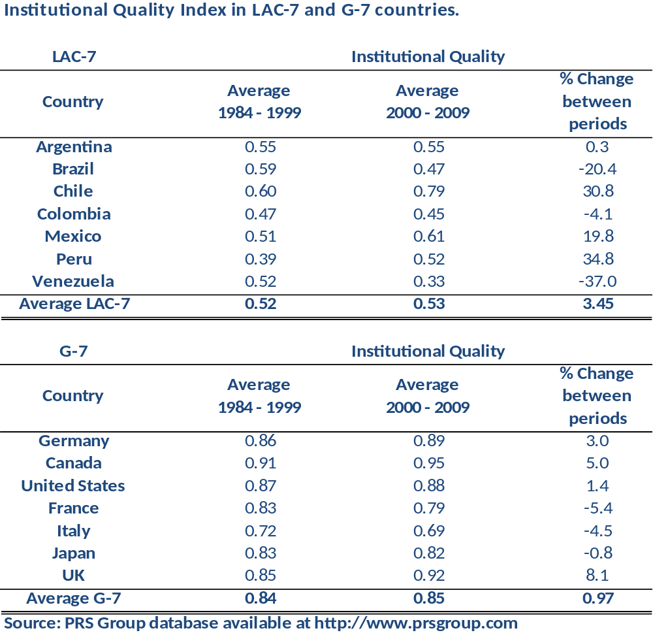
Institutional Quality
Institutional Quality Index: measures easiness to invest, corruption, rule of law and bureaucracy quality from monthly indicators of PRS Group.
A larger number is associated with better functioning institutions.
Average is lower in LAC-7.
Some LAC-7 countries registered large improvements in the XXIst Century.

Slide 4
Monetary Policy Cyclicality
Countercyclical
Source: Overcoming the Fear of Free Falling: Monetary Policy Graduation in Emerging Markets (2012). Carlos Vegh and Guillermo Vuletin.
Notes:
De: http://www.colby.edu/personal/g/gvuletin/Monetary%20graduation.pdf
Figure presents a scatter plot with the 1960-1999 correlation on the horizontal axis and the 2000-2009 correlation on the vertical axis. By dividing the scatter plot into four quadrants along the zero axes, we can classify countries into four categories. Top right: these are countries that have always been countercyclical. Bottom-left: these are countries that have continued to behave procyclically over the last decade. Bottom-right: these are countries that were countercyclical during the 1960-1999 period and turned procyclical over the last decade. Top left: these are countries that used to be procyclical and became countercyclical over the last decade.

Slide 5
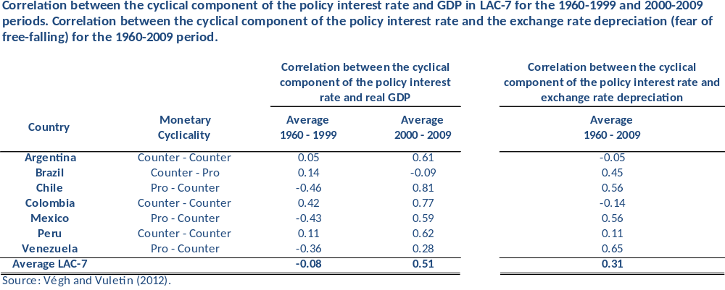
Monetary Policy Cyclicality

Slide 6
Fear of Free Falling and Monetary Cyclicality
Source: Overcoming the Fear of Free Falling: Monetary Policy Graduation in Emerging Markets (2012). Carlos Vegh and Guillermo Vuletin.
Notes:
De: http://www.colby.edu/personal/g/gvuletin/Monetary%20graduation.pdf
In emerging economies, recessions are often associated with capital outflows. This capital outflows triggers a steep depreciation of the domestic currency, which forces the Central Bank to raise interest rates to defend the currency. We refer to this monetary policy reaction as “fear of free falling” (FFF) and we measure it by computing the correlation between the cyclical component of the short term interest rate and the rate of depreciation of the exchange rate. A positive correlation indicates that the short-term policy rate increases when the domestic currency is depreciating, indicating the presence FFF. On the contrary, a zero correlation suggests that the monetary authority does not systematically respond to exchange rate movements. The figure shows that monetary policy is procyclical for high levels of FFF and becomes more countercyclical as FFF diminishes.

Slide 7
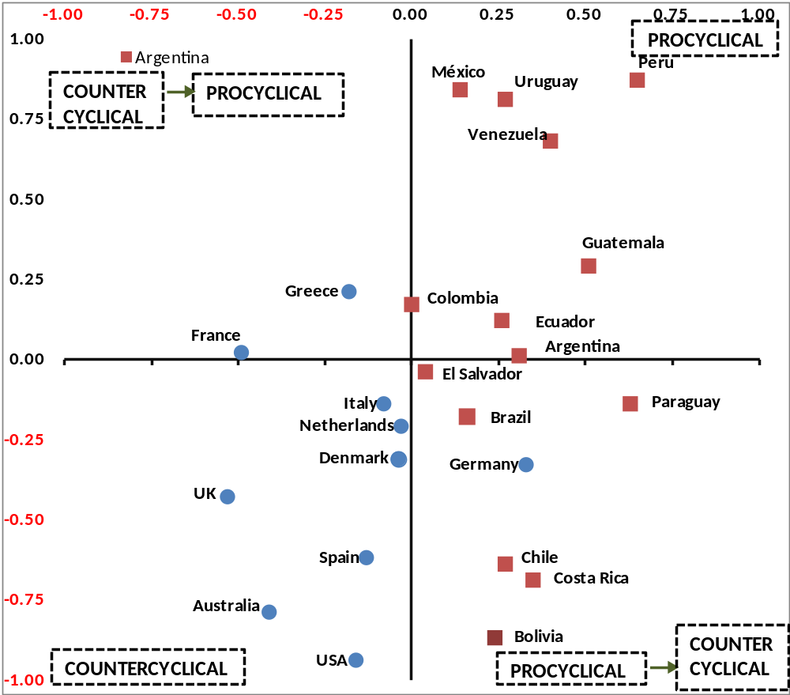
Fiscal Policy Cyclicality
Country Correlation of Government Expenditure and Real GDP
(1960-1999)
Correlation Government Expenditure and Real GDP
(2000-2009)
Source: On graduation from fiscal procyclicality (2011). Jeffrey Frankel and Carlos Vegh.
Notes:
De: http://www.hks.harvard.edu/fs/jfrankel/GraduatnfromprocyclicalityV&V-Jul15.pdf
In the past, industrial countries normally pursued countercyclical fiscal policies, and emerging markets pursued procyclical fiscal policies. However, some emerging countries can now implement countercyclical fiscal policy, as the following graph shows:
GRAPH
A positive correlation means that the cyclical components of government expenditure and real GDP move in the same direction, which would imply that fiscal policy is procyclical.
A negative correlation means that the cyclical components of government expenditure and real GDP move in opposite directions, which would imply that fiscal policy is countercyclical.
The graph plots the correlations between government expenditure and real GDP for the period 1960-1999 in the horizontal axis and for the period 2000-2009 in the vertical axis.
Bottom right quadrant. PROCYCLICAL-COUNTERCYCLICAL Countries that used to be procyclical during the 1960-1999 (positive correlations) but turned procyclical over the last decade, in the period 2000-2009 (negative correlations). Among Latin American countries, include Chile, Brazil, Paraguay, Costa Rica, Bolivia, and El Salvador fall in this category. This represents an improvement, since procyclical fiscal policies reinforce the business cycle and increase macroeconomic volatility, aggravating economic upturns and exacerbating downturns.
Top left quadrant. COUNTERCYCLICAL-PROCYCLICAL. Countries that used to be countercyclical during 1960-1999 (negative correlations) but turned procyclical in 2000-2009 (positive correlations). Used to be Countries like France and Greece behaved in an opposite way, their fiscal policies evolved from being countercyclical to procyclical
Top right quadrant. ALWAYS PROCYCLICAL. Countries that have always behaved procyclical.
Bottom left quadrant. ALWAYS COUNTERCYCLICAL. Countries that have always behaved countercyclical.

Slide 8
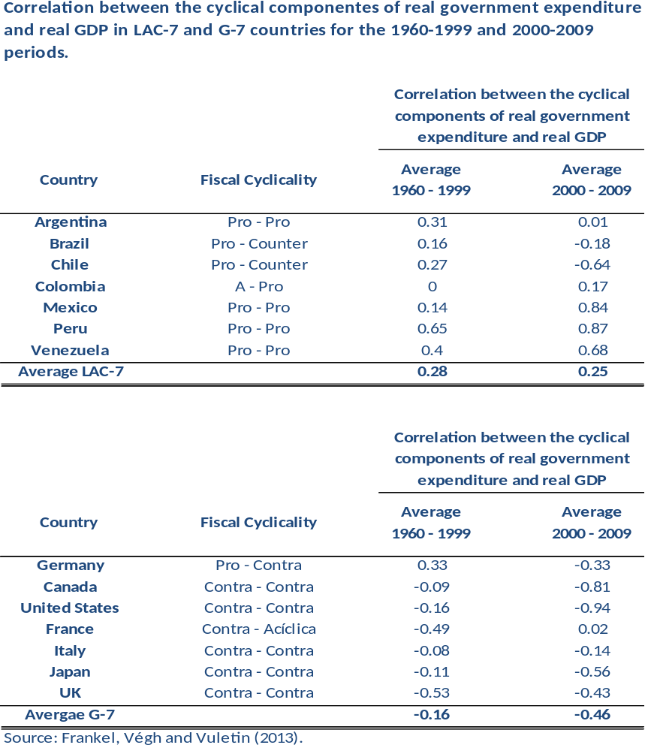
Fiscal Policy Cyclicality

Slide 9
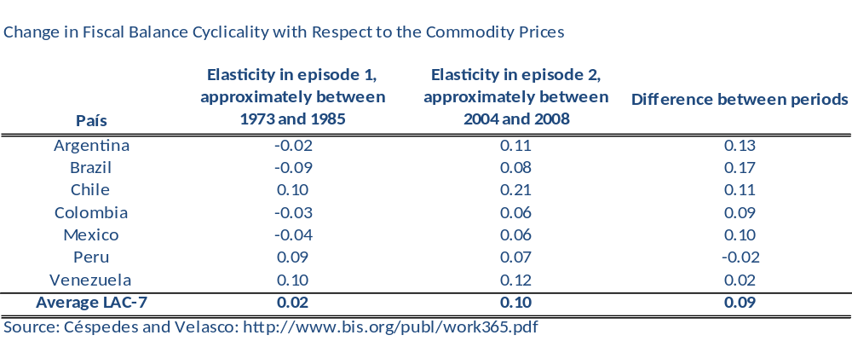
Fiscal Policy Cyclicality and
Terms of Trade Shocks
A negative number is evidence of procyclicality as fiscal balances are deteriorating in response to favorable terms of trade.
There is evidence of an improvement on the fiscal management of terms of trade booms between these two episodes.

Slide 10
Challenge
Understanding the implications of policies for the behavior of macroeconomic variables requires measuring monetary and fiscal policy in a way that they are exogenous.
To capture these exogenous components of monetary and fiscal policies we solve for the joint determination of the policy variables – nominal interest rates, government expenditure and taxation – along with variables that determine, but also respond to, policies such as output gap, inflation, exchange rate and debt’s evolution.
To perform our analysis we estimate a small scale DSGE model with monetary and fiscal factors using Bayesina Maximum Likelihood.

Slide 11
Overview of the results
We explore the interactions between monetary and fiscal policies in Argentina, Brazil, Colombia, Mexico and Peru since the adoption of the inflation-targeting framework in the latter four countries.
A monetary model augmented with fiscal factors has a better fit to macro variables than without fiscal considerations.
There is diversity in the monetary and fiscal reaction functions for the analyzed countries.
Government expenditure multiplier is larger than tax multiplier.

Slide 12
Overview of the results (cont.)
Tight monetary → loose / neutral government expenditure and loose / tight taxation.
Loose expenditure → neutral / tight monetary
and tight taxation
Tight taxation → neutral / tight monetary
and neutral government expenditure.
We are in the process of providing evidence of the cyclicality of monetary and fiscal policies and the relative importance of external factors (terms of trade, export demand, foreign inflation and foreign interest rate shocks) in explaining fluctuations.

Slide 13
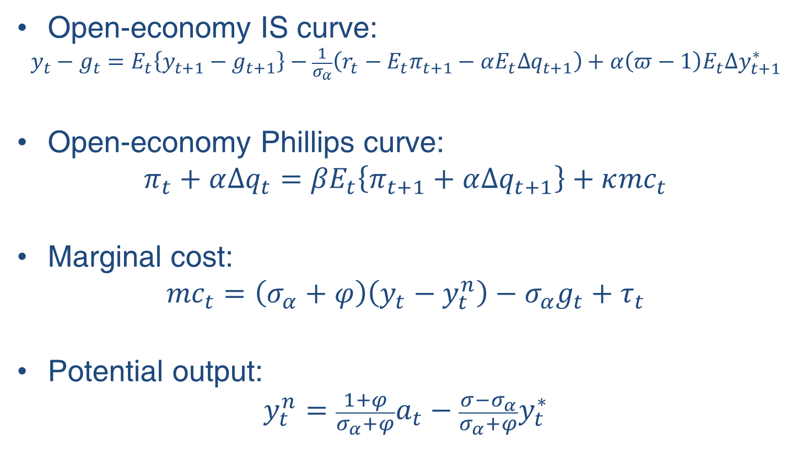
Model: IS and Aggregate Supply
Open-economy IS curve:
$$y_{t}−g_{t}=E_{t}\left\{y_{t+1}−g_{t+1}\right\}−\frac{1}{σ_{α}}\left(r_{t}−E_{t}π_{t+1}−αE_{t}∆q_{t+1}\right)+α\left(π−1\right)E_{t}∆y_{t+1}^{∗}$$
Open-economy Phillips curve:
$$π_{t}+α∆q_{t}={βE}_{t}\left\{π_{t+1}+α∆q_{t+1}\right\}+κ{mc}_{t}$$
Marginal cost:
$${mc}_{t}=\left(σ_{α}+φ\right)\left(y_{t}−y_{t}^{n}\right)−σ_{α}g_{t}+τ_{t}$$
Potential output:
$${y_{t}^{n}=\frac{1+φ}{σ_{α}+φ}a}_{t}−\frac{{σ−σ}_{α}}{σ_{α}+φ}y_{t}^{∗}$$

Slide 14
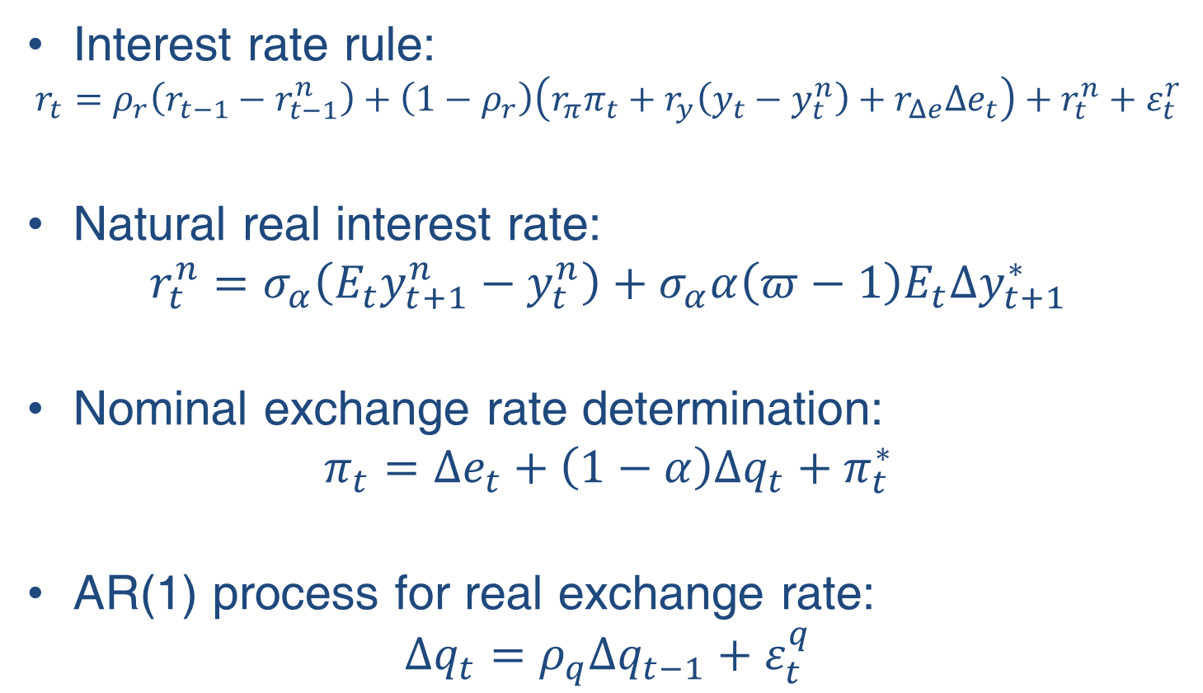
Model: Monetary policy and foreign variables
Interest rate rule:
$$r_{t}=ρ_{r}\left(r_{t−1}−r_{t−1}^{n}\right)+\left(1−ρ_{r}\right)\left(r_{π}π_{t}+r_{y}\left(y_{t}−y_{t}^{n}\right)+r_{Δe}Δe_{t}\right)+r_{t}^{n}+ε_{t}^{r}$$
Natural real interest rate:
$$r_{t}^{n}=σ_{α}\left(E_{t}y_{t+1}^{n}−y_{t}^{n}\right)+σ_{α}α\left(π−1\right)E_{t}∆y_{t+1}^{∗}$$
Nominal exchange rate determination:
$$π_{t}=Δe_{t}+\left(1−α\right)Δq_{t}+π_{t}^{∗}$$
AR(1) process for real exchange rate:
$$Δq_{t}=ρ_{q}Δq_{t−1}+ε_{t}^{q}$$

Slide 15
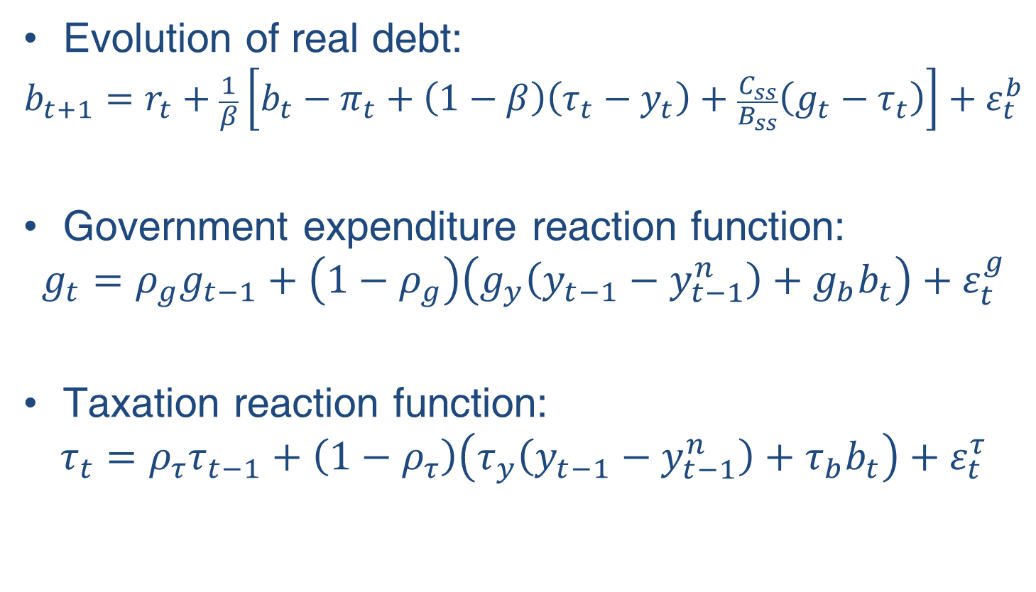
Model: evolution of government debt and expenditure and taxation policies
Evolution of real debt:
$$b_{t+1}=r_{t}+\frac{1}{β}\left[b_{t}−π_{t}+\left(1−β\right)\left(τ_{t}−y_{t}\right)+\frac{C_{ss}}{B_{ss}}\left(g_{t}−τ_{t}\right)\right]+ε_{t}^{b}$$
Government expenditure reaction function:
$$g_{t}=ρ_{g}g_{t−1}+\left(1−ρ_{g}\right)\left(g_{y}\left(y_{t−1}−y_{t−1}^{n}\right)+g_{b}b_{t}\right)+ε_{t}^{g}$$
Taxation reaction function:
$$τ_{t}=ρ_{τ}τ_{t−1}+\left(1−ρ_{τ}\right)\left(τ_{y}\left(y_{t−1}−y_{t−1}^{n}\right)+τ_{b}b_{t}\right)+ε_{t}^{τ}$$

Slide 16
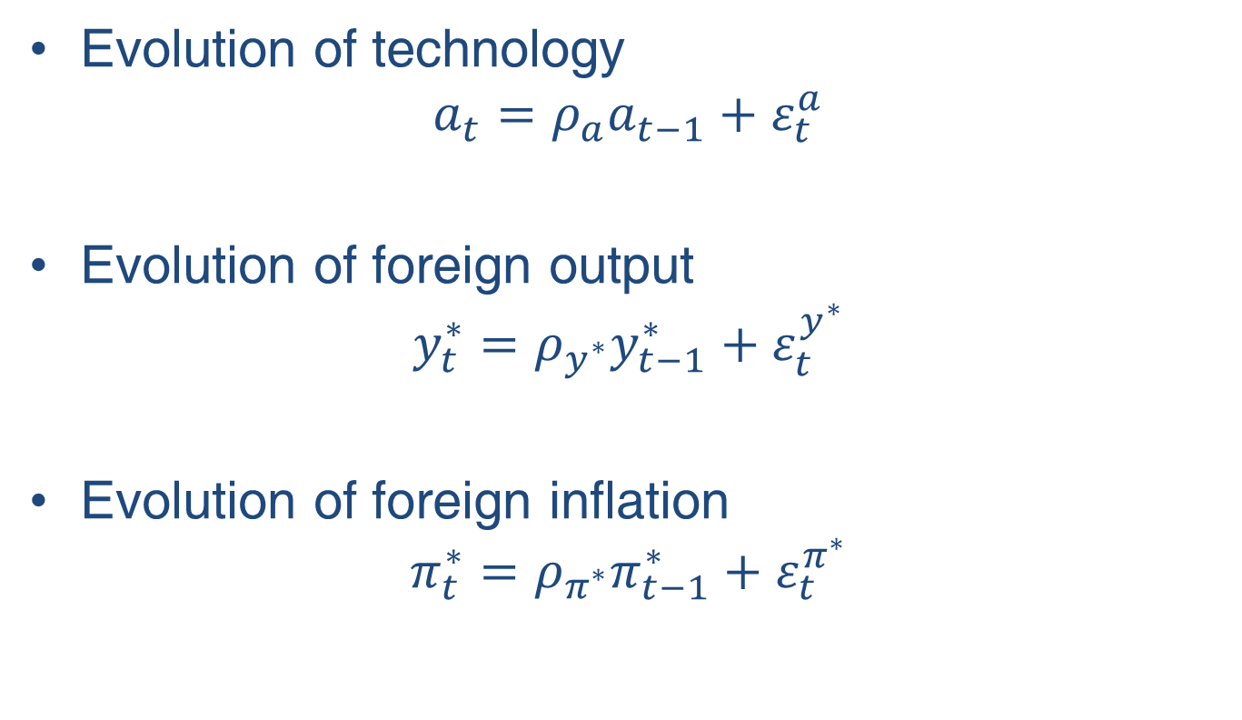
Model: Technology and External Sector
Evolution of technology
$$a_{t}=ρ_{a}a_{t−1}+ε_{t}^{a}$$
Evolution of foreign output
$$y_{t}^{∗}=ρ_{y^{∗}}y_{t−1}^{∗}+ε_{t}^{y^{∗}}$$
Evolution of foreign inflation
$$π_{t}^{∗}=ρ_{π^{∗}}π_{t−1}^{∗}+ε_{t}^{π^{∗}}$$

Slide 17
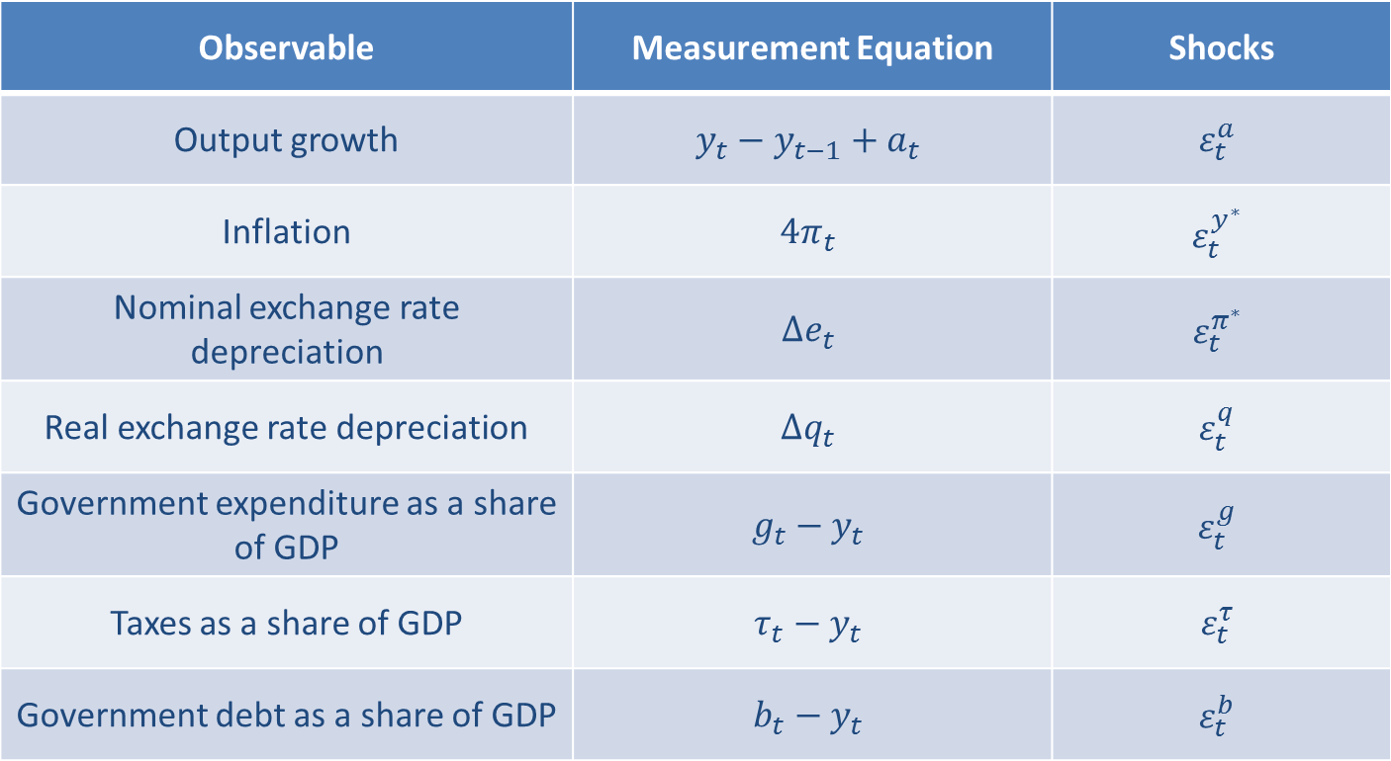
Measurement equations
Observable | Measurement Equation | Shocks
Output growth | $$y_{t}−y_{t−1}+a_{t}$$ | $$ε_{t}^{a}$$
Inflation | $$4π_{t}$$ | $$ε_{t}^{y^{∗}}$$
Nominal exchange rate depreciation | $$Δe_{t}$$ | $$ε_{t}^{π^{∗}}$$
Real exchange rate depreciation | $$Δq_{t}$$ | $$ε_{t}^{q}$$
Government expenditure as a share of GDP | $$g_{t}−y_{t}$$ | $$ε_{t}^{g}$$
Taxes as a share of GDP | $$τ_{t}−y_{t}$$ | $$ε_{t}^{τ}$$
Government debt as a share of GDP | $$b_{t}−y_{t}$$ | $$ε_{t}^{b}$$

Slide 18
Models’ fit comparison
The following table shows the Log Data Density of the monetary and fiscal models, both estimated without fiscal data.
This exercise shows the benefits of adding fiscal factors to fit the macro variables of the monetary model.
 | Monetary Model | Monetary Model Augmented with Fiscal Factors
Argentina | -441.65 | -392.54
Brazil | -662.04 | -614.66
Chile | -597.55 | -565.46
Colombia | -555.95 | -491.17
Mexico | -551.61 | -502.18
Peru | -434.43 | -345.42
Venezuela | -857.42 | -849.54

Slide 19
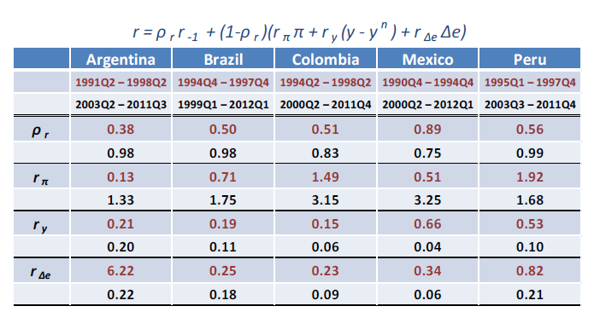
Estimated monetary policy function from a standard DSGE model

Slide 20
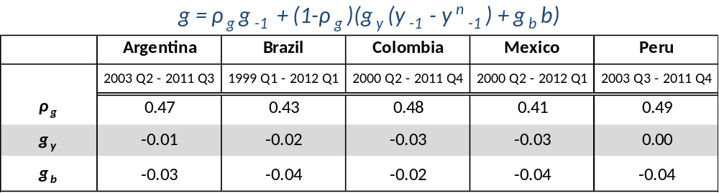
Policy functions from a standard monetary DSGE model with fiscal factors
Low persistence of government expenditure.
Negative elasticity of government expenditure to lagged output gap.
Government expenditure reductions in response to higher indebtedness.

Slide 21
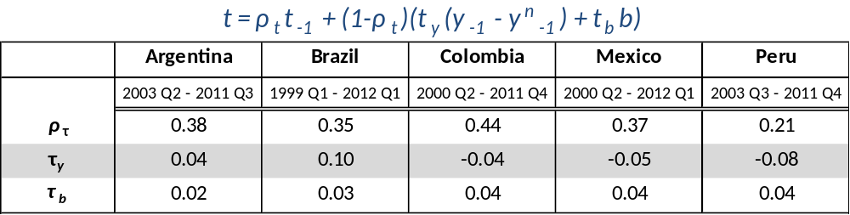
Policy functions from a standard monetary DSGE model with fiscal factors
Even lower degree of tax smoothing.
Taxation increases in response to output expansions in Argentina and Brazil, while it decreases in the other three countries.
Taxation increases in response to higher indebtedness.

Slide 22
Fiscal Multipliers
Government expenditure multiplier is larger than tax multiplier.
Government multiplier is larger in Peru, Brazil and Argentina.
Tax multiplier is significantly smaller in Brazil, where taxation as a share of GDP has increased significantly.
4 quarters | g | t
Argentina | 0.45 | -0.12
Brazil | 0.49 | -0.04
Colombia | 0.22 | -0.11
Mexico | 0.20 | -0.13
Peru | 0.57 | -0.14

Slide 23
Responses to one-standard deviation unexpected increase in interest rates
Lowers output and inflation.
Appreciates the currency.
Increases debt.
Government expenditure increases slightly due to its contracyclical stance.
Due to the generalized increase of indebtedness, taxation increases aggressively in Peru, and slightly in Colombia and Mexico. Meanwhile, in Argentina and Brazil, the contracyclical motive causes a tax reduction.
Tight monetary → loose / neutral government expenditure and
loose / tight taxation.
Monetary | y | π | -Δe | r | g₊₁ | t₊₁ | b
Argentina | ↓ | ↓ | ↑ | ↑ | ↑ | ↓ | ↑
Brazil | ↓ | ↓ | ↑ | ↑ | ↑ | ↓ | ↑
Colombia | ↓ | ↓ | ↑ | ↑ | ↔ | ↑ | ↑
Mexico | ↓ | ↓ | ↑ | ↑ | ↔ | ↑ | ↑
Peru | ↓ | ↓ | ↑ | ↑ | ↑ | ↑ | ↑

Slide 24
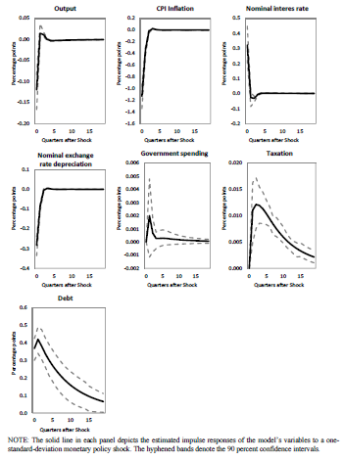
Responses to one-standard deviation unexpected increase in interest rates: Mexico

Slide 25
Responses to one-standard deviation unexpected increase in government expenditure
Increases output and inflation.
Depreciates the currency.
Increases debt.
Taxation rises slightly in response to the higher indebtedness.
Interest rates remain almost unchanged in Argentina, Brazil and Peru, while they rise in Colombia and Mexico.
Loose expenditure → neutral / tight monetary and
tight taxation
Gov´t | y | π | -Δe | r | g | t₊₁ | b
Argentina | ↑ | ↑ | ↓ | ↔ | ↑ | ↑ | ↑
Brazil | ↑ | ↑ | ↓ | ↔ | ↑ | ↑ | ↑
Colombia | ↑ | ↑ | ↓ | ↑ | ↑ | ↑ | ↑
Mexico | ↑ | ↑ | ↓ | ↑ | ↑ | ↑ | ↑
Peru | ↑ | ↑ | ↓ | ↔ | ↑ | ↑ | ↑

Slide 26
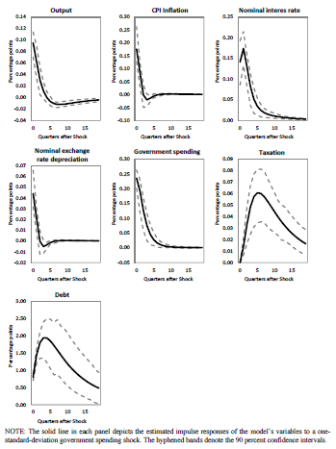
Responses to one-standard deviation unexpected increase in government expenditure: Mexico

Slide 27
Responses to one-standard deviation unexpected increase in taxation
Taxation | y | π | -Δe | r | g₊₁ | t | b
Argentina | ↓ | ↑ | ↓ | ↔ | ↔ | ↑ | ↓
Brazil | ↓ | ↑ | ↓ | ↔ | ↔ | ↑ | ↓
Colombia | ↓ | ↑ | ↓ | ↑ | ↔ | ↑ | ↓
Mexico | ↓ | ↑ | ↓ | ↑ | ↔ | ↑ | ↓
Peru | ↓ | ↑ | ↓ | ↔ | ↔ | ↑ | ↓
Causes stagflation.
Depreciates the currency.
Decreases debt.
Government expenditure remains almost unchanged.
Interest rates remain almost unchanged in Argentina, Brazil and Peru, while they rise in Colombia and Mexico to combat inflation.
Tight taxation → neutral / tight monetary and
neutral government expenditure.

Slide 28
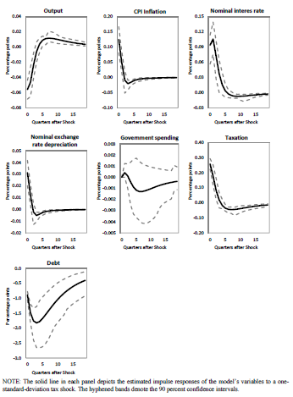
Responses to one-standard deviation unexpected increase in taxation: Mexico

Slide 29
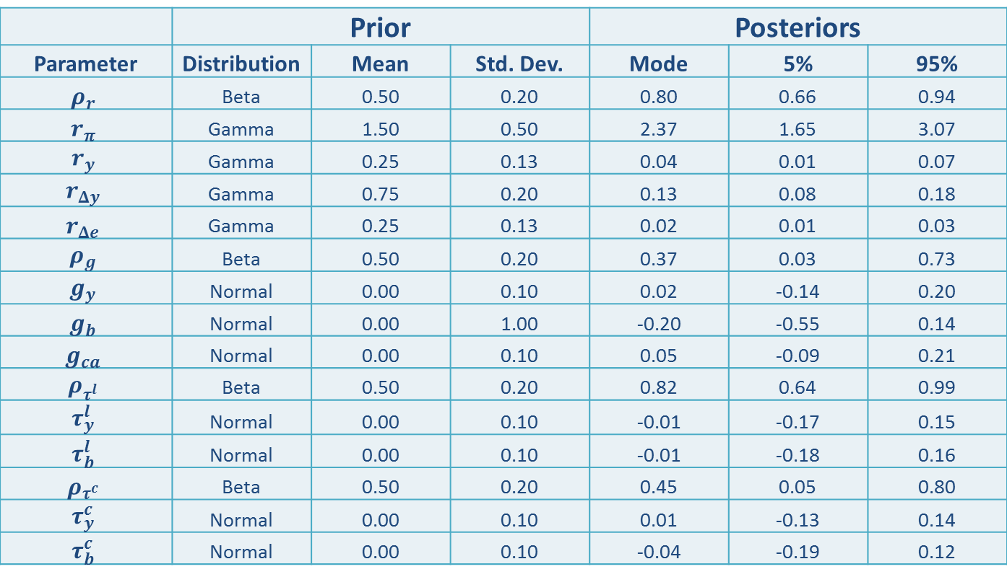
Newer estimation based on an extended model: Colombia
 | Prior |  |  | Posteriors
Parameter | Distribution | Mean | Std. Dev. | Mode | 5% | 95%
$$ρ_{r}$$ | Beta | 0.50 | 0.20 | 0.80 | 0.66 | 0.94
$$r_{π}$$ | Gamma | 1.50 | 0.50 | 2.37 | 1.65 | 3.07
$$r_{y}$$ | Gamma | 0.25 | 0.13 | 0.04 | 0.01 | 0.07
$$r_{Δy}$$ | Gamma | 0.75 | 0.20 | 0.13 | 0.08 | 0.18
$$r_{Δe}$$ | Gamma | 0.25 | 0.13 | 0.02 | 0.01 | 0.03
$$ρ_{g}$$ | Beta | 0.50 | 0.20 | 0.37 | 0.03 | 0.73
$$g_{y}$$ | Normal | 0.00 | 0.10 | 0.02 | -0.14 | 0.20
$$g_{b}$$ | Normal | 0.00 | 1.00 | -0.20 | -0.55 | 0.14
$$g_{ca}$$ | Normal | 0.00 | 0.10 | 0.05 | -0.09 | 0.21
$$ρ_{τ^{l}}$$ | Beta | 0.50 | 0.20 | 0.82 | 0.64 | 0.99
$$τ_{y}^{l}$$ | Normal | 0.00 | 0.10 | -0.01 | -0.17 | 0.15
$$τ_{b}^{l}$$ | Normal | 0.00 | 0.10 | -0.01 | -0.18 | 0.16
$$ρ_{τ^{c}}$$ | Beta | 0.50 | 0.20 | 0.45 | 0.05 | 0.80
$$τ_{y}^{c}$$ | Normal | 0.00 | 0.10 | 0.01 | -0.13 | 0.14
$$τ_{b}^{c}$$ | Normal | 0.00 | 0.10 | -0.04 | -0.19 | 0.12

Slide 30
Historical decomposition of output: Colombia

Slide 31
Historical decomposition of output: contribution of monetary policy

Slide 32
Historical decomposition of output: contribution of government expenditure policy

Slide 33
Historical decomposition of output: contribution of consumption tax policy

Slide 34
Historical decomposition of output: contribution of income tax policy

Slide 35
Historical decomposition of output: contribution of term of trade shocks

Slide 36
Asymptotic Variance Decomposition: Colombia
 | eps_z | eps_pif | eps_pih | eps_risk | eps_i_shock | eps_y_star | eps_i_star | eps_pi_star | eps_g | eps_b | eps_tauc | eps_taul | eps_nti | eps_me_q | eps_me_e | eps_tot
y | 2.2 | 5.6 | 18.5 | 0.1 | 0.7 | 7.0 | 2.5 | 0.7 | 0.3 | 0.0 | 0.0 | 43.2 | 0.0 | 0.0 | 0.0 | 19.2
data_c_y | 1.0 | 14.0 | 0.8 | 6.0 | 0.1 | 30.5 | 12.2 | 8.6 | 1.0 | 0.1 | 0.0 | 9.2 | 0.0 | 0.0 | 0.0 | 16.5
data_dlogy | 1.8 | 11.0 | 8.4 | 0.2 | 1.5 | 16.9 | 13.1 | 3.3 | 0.8 | 0.1 | 0.0 | 4.0 | 0.0 | 0.0 | 0.0 | 38.9
data_dlogs | 0.1 | 8.1 | 0.1 | 0.0 | 0.0 | 5.7 | 0.1 | 0.1 | 0.0 | 0.0 | 0.0 | 0.1 | 0.0 | 0.0 | 0.0 | 85.7
data_i | 9.6 | 5.9 | 4.2 | 4.4 | 0.8 | 15.8 | 10.0 | 21.5 | 1.5 | 0.1 | 0.0 | 3.5 | 0.0 | 0.0 | 0.0 | 22.8
data_dloge | 0.9 | 14.3 | 0.5 | 0.5 | 0.4 | 30.9 | 8.1 | 20.7 | 0.1 | 0.0 | 0.0 | 0.1 | 0.0 | 0.0 | 17.5 | 6.0
data_dlogq | 1.6 | 20.0 | 0.9 | 0.7 | 0.4 | 44.9 | 10.9 | 9.8 | 0.2 | 0.0 | 0.0 | 0.2 | 0.0 | 1.5 | 0.0 | 9.0
data_pi | 17.4 | 0.9 | 12.2 | 2.0 | 19.6 | 8.0 | 10.0 | 12.1 | 1.0 | 0.1 | 0.0 | 9.0 | 0.0 | 0.0 | 0.0 | 7.6
data_pif | 0.1 | 20.1 | 0.1 | 0.1 | 0.1 | 12.8 | 0.2 | 0.5 | 0.0 | 0.0 | 0.0 | 0.2 | 0.0 | 0.0 | 0.0 | 65.9
data_premium | 0.4 | 12.1 | 0.3 | 48.0 | 0.1 | 16.6 | 17.9 | 1.0 | 0.1 | 0.0 | 0.0 | 1.1 | 0.0 | 0.0 | 0.0 | 2.4
data_T_y | 3.7 | 1.7 | 3.8 | 0.4 | 0.1 | 0.6 | 0.9 | 0.3 | 0.1 | 0.1 | 1.2 | 81.5 | 5.2 | 0.0 | 0.0 | 0.5
data_taulwn_y | 2.2 | 2.4 | 8.8 | 0.0 | 0.3 | 2.9 | 1.0 | 0.3 | 0.1 | 0.0 | 0.0 | 73.7 | 0.0 | 0.0 | 0.0 | 8.1
data_taucc_y | 0.9 | 12.2 | 1.5 | 5.1 | 0.1 | 25.5 | 10.4 | 7.3 | 1.2 | 0.4 | 14.4 | 7.7 | 0.0 | 0.0 | 0.0 | 13.4
data_g_y | 1.8 | 4.3 | 12.0 | 0.1 | 0.5 | 5.6 | 2.2 | 0.9 | 14.7 | 1.2 | 0.1 | 41.8 | 0.1 | 0.0 | 0.0 | 14.7
data_b_y | 3.7 | 5.8 | 31.4 | 0.6 | 2.0 | 5.9 | 3.0 | 3.1 | 5.0 | 12.7 | 0.1 | 10.8 | 0.8 | 0.0 | 0.0 | 15.0
data_ca_y | 1.4 | 5.0 | 15.0 | 1.5 | 1.1 | 2.5 | 23.6 | 0.4 | 0.4 | 0.0 | 0.0 | 38.7 | 0.0 | 0.0 | 0.0 | 10.3

Slide 37
Closing remarks
This is work in progress and the goal is to have a country by country analysis of the cyclicality of their macroeconomic policies and the effect that different domestic and external shocks have in explaining their business cycle fluctuations.
All comments or suggestions are greatly appreciated.

Slide 38
Monetary and Fiscal Policies in Latin America:
Evidence from an Estimated DSGE Model
Maritsa Hernández Henao Alberto Ortiz Bolaños
CEMLA CEMLA and EGADE
jhernandez@cemla.org ortiz@cemla.org
Thank you!

